Slide 1
Constitution
Ch. 5
Civics

Slide 2
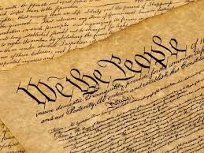
What is a Constitution?

Slide 3
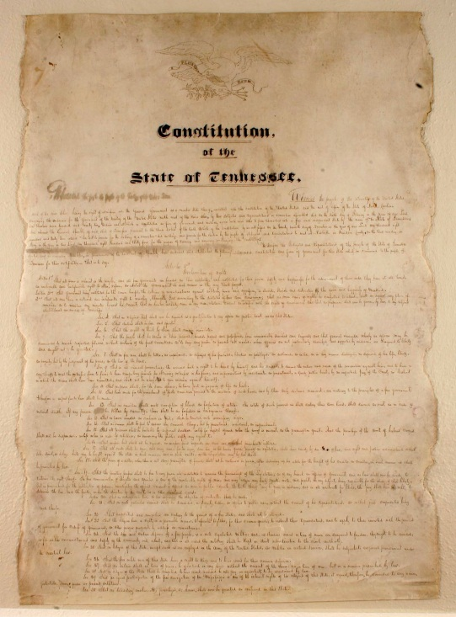
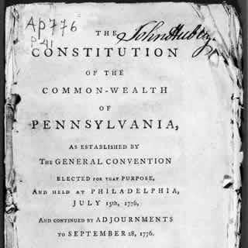
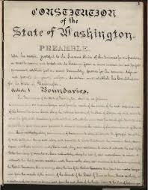
Why do you think each state created its own separate constitution?

Slide 4
What were some of the common features shared by the state constitutions?
(Most had a bicameral legislature, a governor, and state courts. In addition, most contained a bill of rights guaranteeing basic freedoms.)

Slide 5
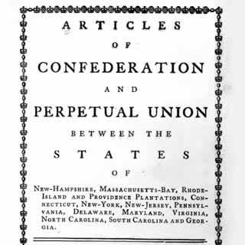
What is a confederation?

