Slide 1
Graphs and Charts
Ch. 5
Constitution

Slide 2
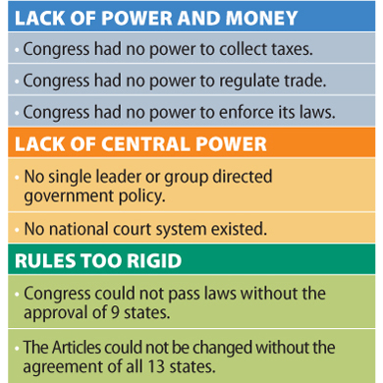
Articles of Confederation Weaknesses

Slide 3
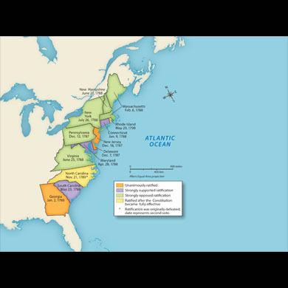
Colonies during Ratification
McGraw book
Ch. 5 Lesson 2

Slide 4
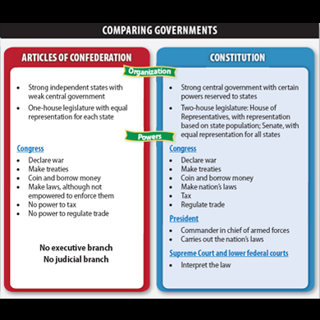
Comparing Governments

Slide 5
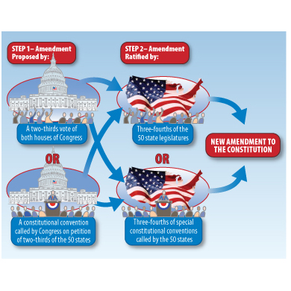
Steps to Amend the Constitution

Slide 6
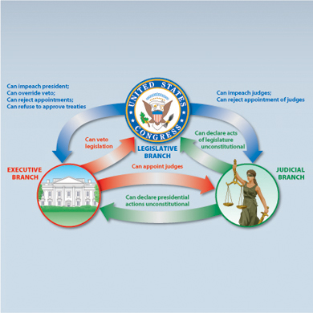
Checks and Balances

Slide 7
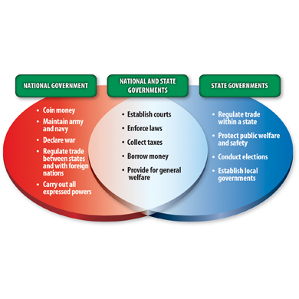
Concurrent Powers

