Slide 1
Ch. 6: The bill of rights
civics

Slide 2
Lesson 1: The first amendment

Slide 3
Lesson 1: The first amendment
Citizens of the United States have the right to certain basic civil liberties, some of which are found in the First Amendment.

Slide 4
Lesson 1: The first amendment
Under the First Amendment, the government may not establish a state religion, and individuals are free to practice their faith.

Slide 5
Lesson 1: The first amendment
The First Amendment right to free speech allows citizens to express their views both privately and publicly.

Slide 6
Lesson 1: The first amendment
Limits on free speech include a ban on speech that can lead to criminal acts and a ban on spreading lies that can harm a person’s reputation.

Slide 7
Lesson 1: The first amendment
Freedom of the press prevents government censorship of news.

Slide 8
Lesson 1: The first amendment
Freedom of assembly allows people to gather in groups.

Slide 9
Lesson 1: The first amendment
Freedom to petition allows individuals to send requests for action to the government.

Slide 10
Lesson 2: Other bill of rights protections

Slide 11
Lesson 2: Other bill of rights protections
The Fourth, Fifth, Sixth, and Eighth Amendments protect the rights of people who are accused of a crime.

Slide 12
Lesson 2: Other bill of rights protections
The Fourth Amendment protects against searching someone’s property or taking things he or she owns without probable cause.

Slide 13
Lesson 2: Other bill of rights protections
The Fifth Amendment requires that anyone accused of a crime must be given due process. This includes making a formal charge or indictment.

Slide 14
Lesson 2: Other bill of rights protections
The Sixth Amendment guarantees a speedy trial and the right to a jury trial.

Slide 15
Lesson 2: Other bill of rights protections
The Seventh Amendment protects against excessive bail and cruel and unusual punishment.

Slide 16
Lesson 2: Other bill of rights protections
The Second Amendment allows people to “keep and bear arms.” Courts have generally ruled that states can make laws to control gun ownership.

Slide 17
Lesson 2: Other bill of rights protections
The Seventh Amendment guarantees the right to a jury trial in civil cases and describes the roles of judges and juries.

Slide 18
Lesson 2: Other bill of rights protections
The Tenth Amendment states that any powers the Constitution does not specifically give to the federal government belong to the people.

Slide 19
Lesson 3: Furthering Civil Liberties

Slide 20
Lesson 3: Furthering Civil Liberties
The 13th, Fourteenth, and Fifteenth Amendments were passed after the Civil War to give more rights to African Americans.

Slide 21
Lesson 3: Furthering Civil Liberties
The Thirteenth Amendment outlawed slavery and banned forced labor, freeing hundreds of thousands of African American slaves.

Slide 22
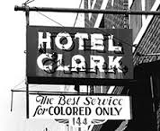
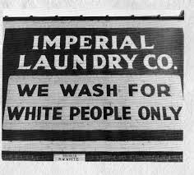
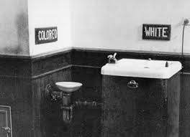
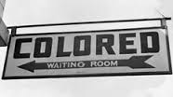
Lesson 3: Furthering Civil Liberties
“Black codes” in many Southern states deprived African Americans of rights. The Fourteenth Amendment made these laws illegal by requiring states to give all citizens equal protection of the law and due process.

Slide 23
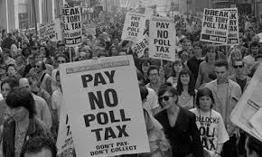
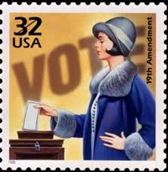
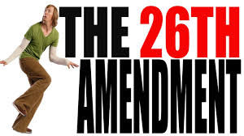
Lesson 3: Furthering Civil Liberties
Other amendments to the Constitution changed voting rights. Some allowed new groups to vote, including African Americans (Fifteenth Amendment), women (Nineteenth Amendment), citizens living in Washington, D.C. (Twenty Fourth Amendment), and young people aged 18 and up (Twenty-Sixth Amendment).

