Slide 1
Public opinion & government
Ch. 12 - civics

Slide 2
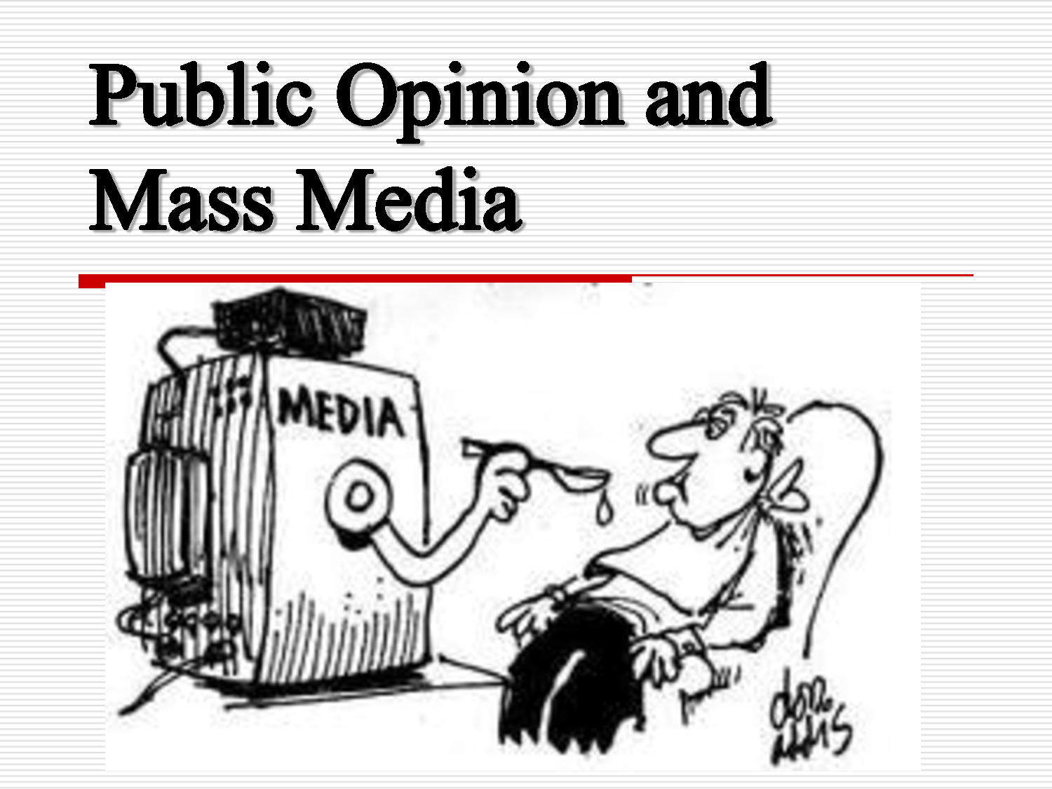
Lesson one
Forming Public Opinion

Slide 3
The Obligations and Responsibilities of U.S. Citizenship
Citizenship brings with it both obligations and responsibilities. The obligations of citizenship include those actions that citizens are required by law to take while the responsibilities of citizenship are those actions that citizens should take for the sake of the common good.
http://www.cnn.com/studentnews/
http://www.timeforkids.com/
http://teacher.scholastic.com/activities/scholasticnews/index.html

Slide 4
Sources of public opinion
Background
  Age, Gender, Education, Race, Religion, Job, Income, Where you live
Mass media
  Television, radio, Internet Web sites, newspapers, magazines, books, recordings, and movies
Interest groups
  They try to convince other people to adopt their point of view
  Convince public officials to support their position
  Put political pressure on leaders to act a certain way

Slide 5
Features of Public Opinion
Public opinion is often described in terms of three factors.
They are:
  direction
  Intensity
  stability.
Each measures a different aspect of public opinion.

Slide 6
3 Factors on public opinion
Direction refers to whether public opinion on a topic is negative or positive
Intensity refers to how strongly a person or group holds an opinion on an issue
Stability is a matter of how firmly people hold to their views

Slide 7
Public opinion polls
Polls measure public opinion
Pros
  Polls provide general information about citizens’ concerns
  Polls provide public officials timely feedback from citizens
  Polls categorize responses of specific groups of voters (men & women, older & younger people)
Cons
  Polls lead politicians to focus on pleasing the public instead of acting for the common good
  Polls can affect how and whether people vote

Slide 8
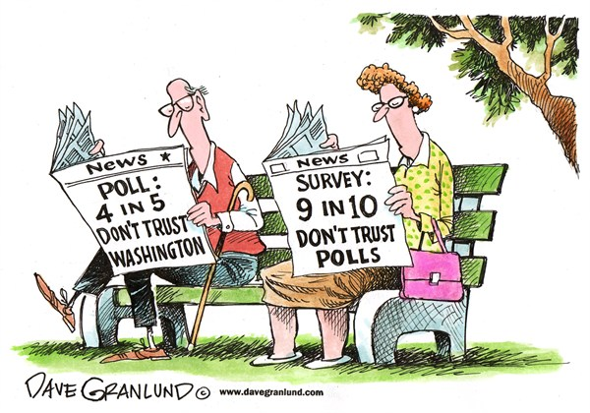
Polls political cartoon
This cartoon makes a comment about opinion polls and survey.
Polls are constantly used by politicians to get a measure of how voters are feeling on issues of the day.
Both newspapers have headlines about opinion polls. News stories often rely on such polls, and the cartoonist may feel these polls are used too frequently.
According to the polls taken by these newspapers, fewer people trust polls than trust Washington.

Slide 9

Lesson two
The Mass Media

Slide 10
Mass media sources
Print Media
  Newspapers
  Magazines
  Newsletters
  Books
Electronic Media
  Radio
  Television
  Internet

Slide 11
America’s use of mass media
 | Television | Radio | Newspaper | Internet
18 to 24 years old | 89% | 82% | 61% | 90%
25 to 34 years old | 90% | 84% | 62% | 82%
35 to 44 years old | 96% | 86% | 70% | 82%
45 to 54 years old | 97% | 85% | 78% | 82%
55 o 64 years old | 98% | 81% | 76% | 70%
65 years & older | 99% | 61% | 80% | 40%

Slide 12
The press: freedoms and restrictions
Freedoms and Protections
  First Amendment: “Congress shall make no law . . . Abridging (limiting) the freedom of . . . The press.”
  No prior restraint (government censorship before it is published)
  Shield laws (right to protect reporter’s sources)
Restrictions
  Prohibition against libel (evidence of malice)
  Government regulation of broadcast media (FCC)

Slide 13
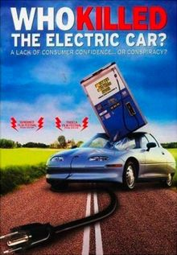
Lesson three
Interest Groups and Lobbying

Slide 14
Lobbyists
Skills Lobbyists Need
  Knowledge of how the government works
  Knowledge of the cause for which they lobby
  Skill for public relations (the business of developing public understanding and goodwill toward a certain matter)
  Ability to make friends
  Ability to speak persuasively
What Lobbyists Do
  Represent interest groups
  Attempt to shape public policy regarding a particular cause
  Contact lawmakers and other government officials directly about their cause
  Provide government officials with information that helps their cause
  Suggest solutions to problems related to their cause
  Write drafts of bills concerning their cause for lawmakers to consider, and testify before Congress about these bills
  If their bill becomes law, make sure it is enforced

Slide 15
Interest groups, public policy, & Special interest groups
Interest groups influence public policy by:
  Taking an active role in elections
  Working through the courts
  Influencing public officials directly through lobbying
  Shaping public opinion
Special Interest Groups
  Pros – make groups’ wishes known and way for ordinary people to join forces
  Con – too much power over elected officials and more influence than ordinary voters

