Slide 1
America & Foreign Affairs
Civics – Ch. 25

Slide 2
Why do nations depend upon one another
Global interdependence means that people and nations rely on one another for goods and services. If Americans want bananas, or other tropical fruit, they must trade with other nations to get them.
People around the world exchange what they have or make for things they do not have.
Developed nations usually buy raw and local products, such as bananas, from developing nations.
Developing nations buy things like technology and medicine from developed countries.

Slide 3
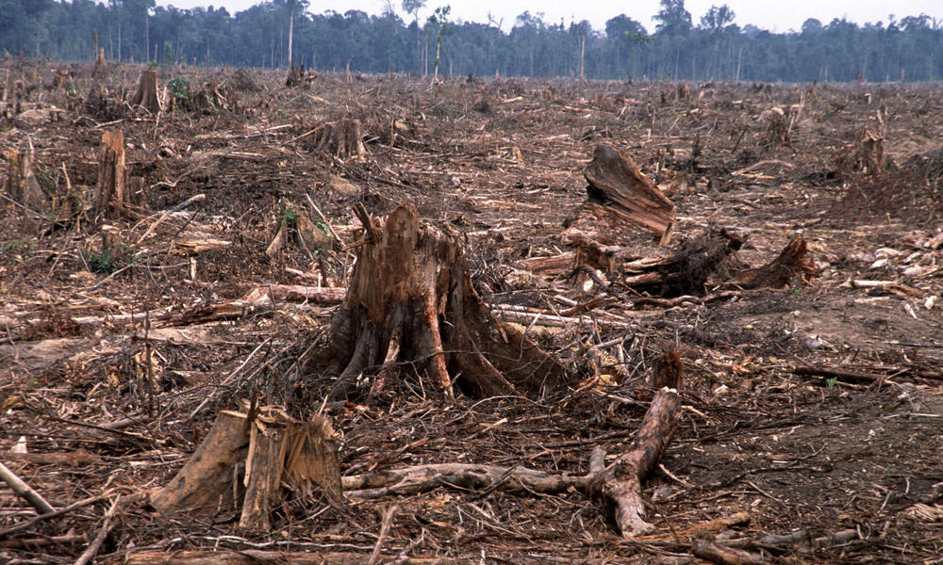
Deforestation: Causes & Effects
There are many causes of deforestation. Land is cleared for agriculture or urban development. Large areas of forests are cut for fuel and for lumber markets.
Fewer trees means that less of Earth’s carbon dioxide is absorbed and less oxygen is produced. This can increase global warming.
Deforestation also dries the land and causes erosion, which can raise the risk of mudslides in elevated areas.
Deforestation contributes to poor agriculture, climate change, and loss of animal and plant life.
Rising sea levels can also result from global warming and climate change, causing widespread flooding of coastal areas.
Deforestation requires countries to work together, because its effects reach beyond the borders of any single nation.

Slide 4
Global challenges
Terrorism – the use of violence or the threat of violence to make people afraid and to force people – or governments – to behave in a certain way.
Refugees – have been driven from their homes by famine, conflicts, or natural disasters.
Diplomats – officials who represent their country’s government, meet and try to work out ways to address common concerns
Cultures – the ideas, customs, art, behaviors, and beliefs of a people or group of people
Human right – basic freedoms that all people should have simply because they are human – adequate food, safety, and shelter.
Repression – means to prevent people from expressing themselves or from freely engaging in normal life.
Genocide – the attempt to kill all members of a particular ethnic group

Slide 5
International organizations
Governmental Organizations
  Created by nations
  Made up of member nations
  Funded by governments
  Examples: United Nations (UN), World Trade Organization (WTO), World Health Organization (WHO), European Union (EU), North Atlantic Treaty Organization (NATO)
Nongovernmental Organizations (NGOs)
  Created by individuals
  Made up of individuals
  Funded by private donations
  Examples: International Red Cross, Doctors Without Borders, Nature Conservancy

Slide 6
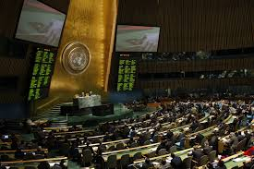
United Nations

Slide 7
United nations organizations
While UN delegates come together in the general assembly to debate and vote on issues, the real work of the UN, not unlike the U.S. Congress, is conducted by committees & councils working behind the scenes to handle specific areas and problems. Here are some of the many groups that are part of the United Nations.
The Security Council
The General Assembly
Specialized Agencies, Related Organizations, Funds, and Other UN Entities
The Economic & Social Council

Slide 8
United nations organizations
The Security Council includes:
  Counter-Terrorism Committee
  UN Peacebuilding Commission
  Working Group on Children and Armed Conflict
The General Assembly includes:
  International Trade Center
  United Nations Children’s Fund (UNICEF)
  United Nations World Food Program
Specialized Agencies, Related Organizations, Funds, and Other UN Entities include:
  International Monetary Fund
  World Health Organization
  World Trade Organization
The Economic & Social Council includes:
  UN Forum on Forests
  International Narcotics Control Board
  Commission for Social Development

Slide 9
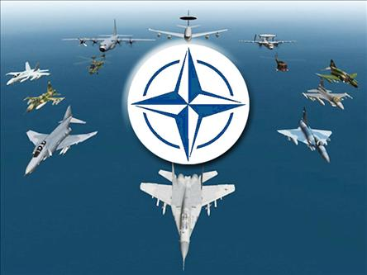
The north atlantic treaty organization (NATo)
The North Atlantic Treaty Organization (NATO) began as a military alliance during the Cold War (1945-1991)
NATO’s member nations agreed to defend one another in the event of conflict with the USSR and its Warsaw Pact allies (Albania, Bulgaria, Czechoslovakia, East Germany, Hungary, Poland, and Romania)
As the Cold War drew to an end, NATO’s role shifted to include diplomacy, trade, and combating international terrorism.

Slide 10
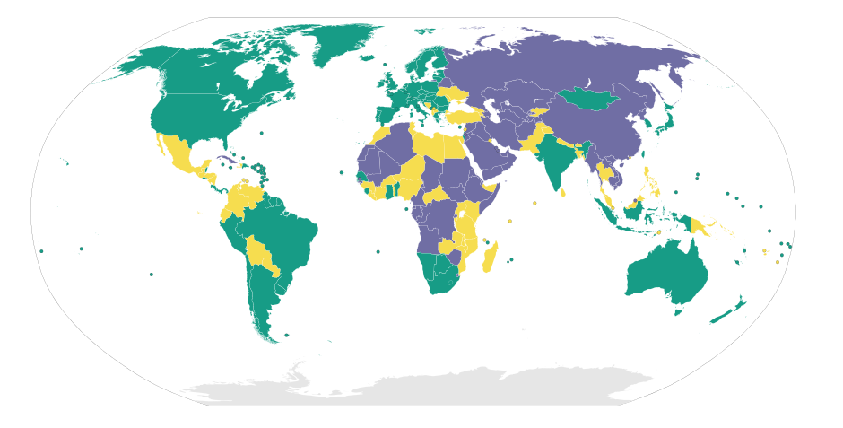
Freedom of the world
Green – Free Country
Yellow – Partially Free Country
Purple – Not Free

Slide 11
Types of government around the world
Representative Democracy/Republic
Argentina
Chad
Chile
Finland
France
United States
In this type of government, the peoples’ elected representatives, not the people themselves, vote on most legislation.

Slide 12
Types of government around the world
Dictatorship/Authoritarian/Military Regime
Burma
China
Libya
Cuba
North Korea
Syria
In this type of government, a single ruler or a small group of rulers holds absolute power and is not subject to election by or the approval of the people.

Slide 13
Types of government around the world
Constitutional Monarchy
Denmark
Jordan
Luxembourg
Netherlands
Norway
Spain
In this type of government, rule is by heredity right, which means the power is handed down from generation to generation, usually within one family. Although leaders are not elected, there is often a constitution that limits the monarch’s authority

Slide 14
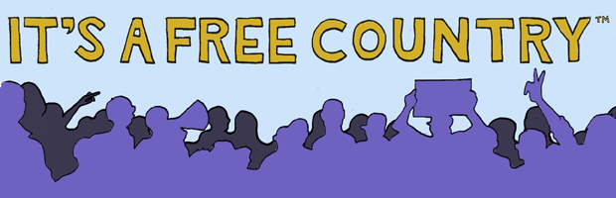
What makes a country free
Open political debate
More than one political party
Fair and free elections
Freedom of the press
Freedom of speech
Freedom of association
Freedom of religion
Respect for the rule of law

