Slide 1
Civics
Ch.3
Section 1

Slide 2
Key Terms
Immigrant – an individual who moves permanently to a new country
Ethnic Group – a group of people who share a common national, cultural, or racial background
Values – the general principles or beliefs people use to make judgments and decisions
Institution – Key practices, relationships, or organization in a society
Popular Sovereignty – the idea that government receives its power from the people.
Distinct – separate or noticeably different
Arbitrary – unrestrained; not agreed upon

Slide 3
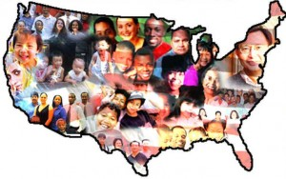
A Diverse Population
Foreign-born people are immigrants, or people who move permanently to a new country.
About 98% of all the people now living in the United States are descended from families who once lived in another country.
Many were fleeing poverty and disease in their home country.

Slide 4
Immigration to the United States
Country | Immigrants to the U.S. (1880-1920)
Austria/Hungary | 400,494
China | 118,393
France | 216,510
Germany | 2,527,202
Ireland | 1,529,144
Italy | 4,114,103
Japan | 241,846
Poland | 153,339
Norway/Sweden | 1,491,151
Russia/USSR | 3,241,098
Immigrants left their homelands and came to the United States to escape high unemployment, poverty, illness, religious persecution, and military rule.

Slide 5
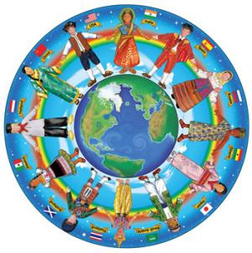
American Diversity
The American population is very diverse and people belong to a variety of racial and ethnic groups.
Ethnic groups share a common national, cultural, or racial background.

Slide 6
Culture
Religious beliefs
Food
Hairstyles
Games
Sports
Jokes and humor
Holidays
Language
Clothing
Music
Dances
Celebrations
Sayings and wisdom
House styles
Culture is the way of life of a group of people. It includes a group’s language, customs, beliefs, and traditions.
All of the following are aspects of culture:

Slide 7
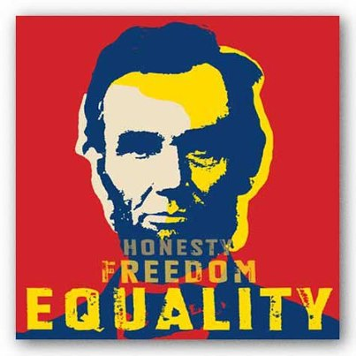
Values and Institutions
The general principles, or beliefs, you use to make these judgments' are your values.
  Values are broad ideas about what is good and desirable and what is bad or not desirable.
America has many different people with diverse backgrounds and beliefs.
Americans, regardless of background, share some of the same fundamental values, such as: freedom, equality, opportunity, justice, unity, respect for one another, tolerance, and democracy.
The Declaration of Independence states that all people are equal, how important freedom is, and says that all Americans have the right to “life, liberty, and the pursuit of happiness.”

Slide 8
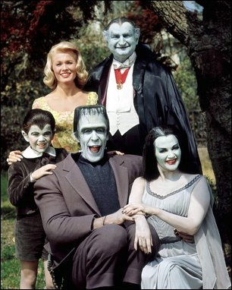
Social Institutions
Institutions are the key practices, relationships, and organizations in a society.
Most important institution in America is the family
Family is the center of social life
In families, parents/older family members teach children their values, both personal and national.
There are religious institutions like churches, temples, and mosques that give a sense of meaning and belonging to the people who worship there.
Schools reflect society’s culture, history, and knowledge.
Social institutions such as clubs and volunteer groups bring together people who have similar values or who believe in the same cause.

Slide 9
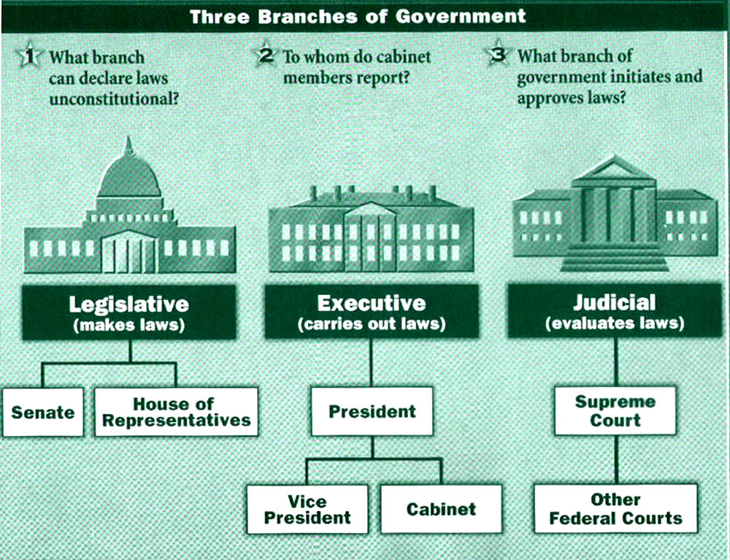
Government Institutions
Freedom is the right to make one’s own choices in life without arbitrary, or restrained, interference from the government.
Popular sovereignty is the idea that the government receives its power from the people.
The people choose the nation’s leaders, and those leaders must face the people again to stay in office.
The Constitution makes sure that the government is limited in its power.
It sets up a three-part government in which no one part can have more power than the other two.
The Bill of Rights makes sure that the government cannot abuse its power over the individual.

Slide 10
Becoming a Citizen
Lesson 2

Slide 11
Key Terms
Citizen – a member of a community of people who owe loyalty to a government and, in turn, are entitled to its protection
Civics – the study of the rights and duties of citizens
Citizenship – the rights and duties of a citizen
Government – the ruling authority for a community
Naturalization – a legal process to obtain citizenship
Alien – a foreign-born resident of the United States who has not been naturalized
Refugee – a person who has left his or her home to escape danger such as persecution by the government, war, or natural disaster.

Slide 12
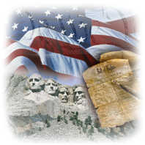
What is Civics?
Citizens have duties and rights like a child has responsibilities and privileges.
Citizens are members of a community who owe loyalty to a government and, in turn, are entitled to the protection of that government.
Civics is the study of the duties and rights of citizens.
“Whenever the people are well-informed, they can trusted with their own government.” – Thomas Jefferson
To have an effective government, citizens must understand their rights and responsibilities.
Informed citizens are able to make wise decisions about public questions and are well prepared to make choices about who should serve in public office

Slide 13
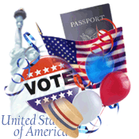
Roots of Citizenship
The idea of citizenship, or the rights and duties of citizens dates back more than 2,500 years to ancient Greece and Rome.
Citizenship gave people legal rights and allowed them to take part in government.
Citizens duties to the government, or the ruling authority for a community, included paying taxes and serving in the armed forces.

Slide 14
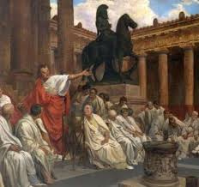
Roots of Citizenship
America and France changed some of the ideas of ancient Greece and Rome.
They defined citizens in terms of belonging to a nation.
They said that the power of the government came from the people governed.
Also known as “consent of the governed.”
Initially limited to just white men.
Gradually, and with much struggle, other groups gained full citizenship.

Slide 15
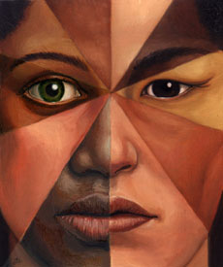
Roots of Citizenship
African-Americans were made citizens through the 14th Amendment in 1868.
Women gained the right to vote in 1920 through the 19th Amendment.
Members of a few Native American groups became citizens through treaties with the federal government.
In 1924, Congress passed the Indian Citizenship Act making all Native American citizens.
Citizenship in the U.S. is not based on wealth, gender, race, or religion.

Slide 16
Citizens and Resident Aliens
Both
Resident Aliens
Citizens
Hold jobs
Own property
Attend public schools
Receive government services
Pay taxes
Are protected by law
Vote
Run for public office
Serve on juries
Work in most government jobs
Must always carry identification card showing status as a legal alien

Slide 17
Foreign-Born People Living in the U.S.
A resident alien is a legal immigrant who has permission to live permanently in the United States without becoming a citizen
A nonresident alien has permission to be in the United States for a limited period of time
An illegal alien does not have permission to be in the United States

Slide 18
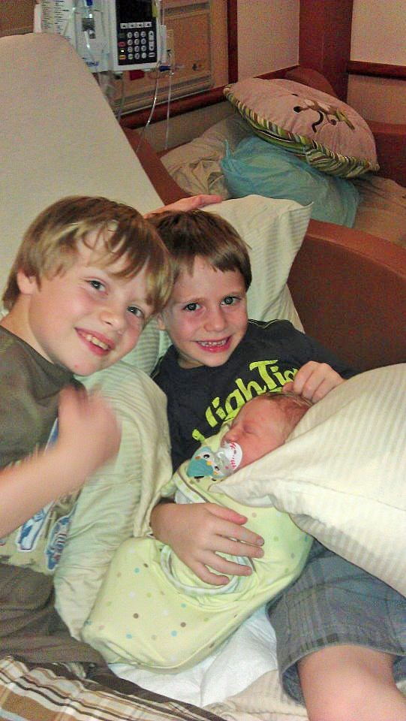
How to become a citizen
There are two ways that a person can become an American citizen.
You can either become a citizen by being born in the United States.
Or you can become a citizen by going through a particular process.

Slide 19
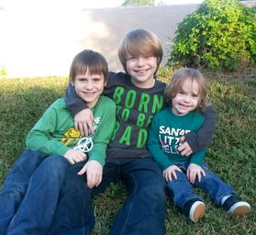
Natural-Born Citizens

Slide 20
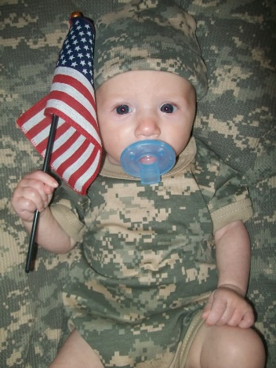
Natural-Born Citizens
Any person born in any of the 50 states or in the District of Columbia automatically becomes an American citizen at birth.
The same is true if someone is born in an American territory, such as Puerto Rico, or a military base overseas.
The rule also applies to children born on American soil to people who are not U.S. citizens.

Slide 21
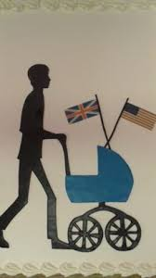
Natural-Born Citizens
A person born in another country can claim American citizenship in two cases.
If both parents are U.S. citizens or if one parent is a citizen who has lived in the United States.
Someone born in another country can also hold dual citizenship, that is, they can be a citizen of both the U.S. and the country where they were born.

Slide 22
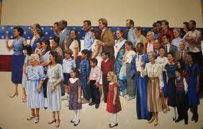
Naturalized Citizens
Naturalization is a legal process to obtain citizenship.
Over 40% of the foreign-born people who live in the U.S. are naturalized citizens.

Slide 23
Naturalized Citizens
The first step in this process is to complete an application and send it to the U.S. Citizenship and Immigration Services (USCIS).
An official from USCIS will interview the applicant to make sure the person meets all five requirements
The next step is to take a citizenship exam. This exam tests the ability to read, write, and speak English. Also tests the applicants knowledge about the history and government of the United States.
Last step is to take an oath at a special ceremony in which the applicant swears to be loyal to the U.S. above all other countries and signs a document saying so.
  Must also swear to obey the Constitution and this countries laws.
  All children under 18 automatically become citizens too.
Immigrants who want to become U.S. citizens must meet certain requirements:
  Must be 18 or older
  Must have been a lawful permanent resident for five years
  Must be able to read, write, and speak English
  Must be of good moral character
  Must show an understanding of U.S. civics

Slide 24
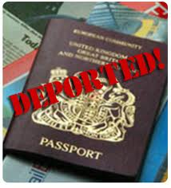
Losing Citizenship
Americans can lose their citizenship in three ways:
Expatriation
  Someone who gives his or her allegiance to a foreign country is expatriated.
  An example is a person who becomes a naturalized citizen of another country.
Denaturalization
  Naturalized citizens who are found to have lied on their citizenship application are denaturalized.
  They may then be deported or sent out of the country.
Being convicted of certain crimes
  The crimes are treason, taking part in a rebellion, and trying to overthrow the government by violent means.
  Those guilty of any of three very serious crimes can lose citizenship.

Slide 25
Complete the top chart by writing requirements for becoming a naturalized U.S. citizen. Complete the bottom chart by writing causes for a loss of citizenship.
How to Become a Naturalized U.S. Citizen
How to Lose U.S. Citizen Citizenship

Slide 26
Complete the top chart by writing requirements for becoming a naturalized U.S. citizen. Complete the bottom chart by writing causes for a loss of citizenship.
How to Become a Naturalized U.S. Citizen
Be a lawful, permanent resident for at least 5 years
Be able to read, write, and speak English
Be 18 years or older
Have a good moral character
Show an understanding of U.S. Civics
How to Lose U.S. Citizen Citizenship
Expatriation (by swearing allegiance to a foreign country)
Being convicted of treason, taking part in a rebellion, or by trying to overthrow the U.S. government by violent means
Denaturalization (for lying on application for citizenship)

Slide 27

Losing Citizenship
Only the federal government can grant citizenship or take it away.
States can deny, or take away, some privileges of citizenship.
States can take away the right to vote from some criminals but they cannot take away citizenship itself.

Slide 28
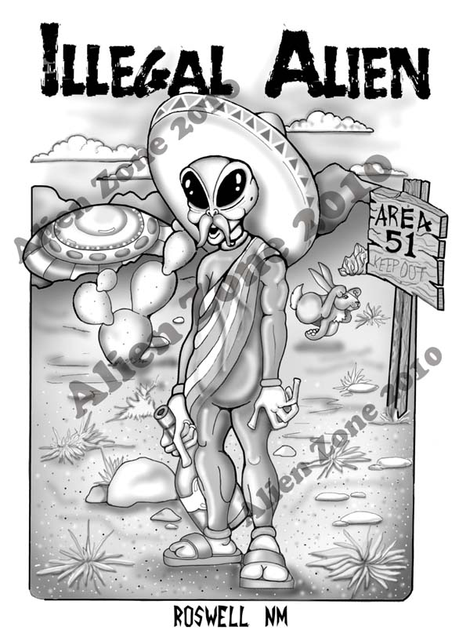
Foreign-Born Residents
Not everyone in the U.S. is a citizen.
Many people are aliens, or foreign-born residents who have not been naturalized.
There are two categories:
  Those who are here legally
  Those who are not here legally

Slide 29
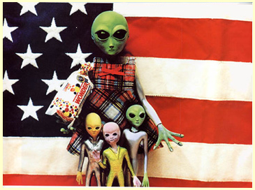
Legal Aliens
There are two categories of legal aliens.
A resident alien is a legal immigrant who permanently lives in the United States and can stay as long as they wish.
  They pay taxes, have the right to be protected by the law, can hold jobs, own property, attend public schools, & receive other government services
  Cannot vote, serve on jury’s, run or hold office, or work for the government.
  Must carry identification cards with them at all times
A nonresident alien is someone who expects to stay in the U.S. for a short period of time.
  E.g. a reporter who has come over to report on an election

Slide 30
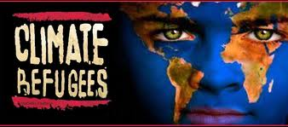
Refugees
A refugee is a person fleeing his or her country to escape danger.
When someone is a political refugee, the government promises to protect him or her.
The government grants this status to people only if they can prove that they really are in danger if they return to their homeland.

Slide 31
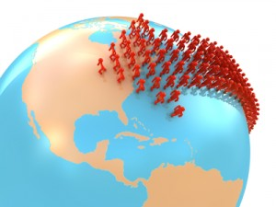
Illegal Aliens
The U.S. limits the amount of immigrants who can enter each year to about 1 million people.
Relatives of U.S. citizens receive the highest priority, or highest ranking.
Priority is given if they have job skills that are needed by employers in the U.S.
The law also makes room for immigrants from countries that have provided fewer numbers of immigrants in the past.

Slide 32
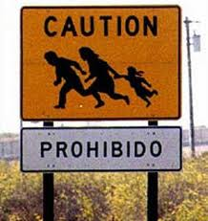
Illegal Aliens
There are usually more people that want to come in than the law allows.
  Some people decide to sneak in without the government allowing it.
  Some were refused admittance to immigrate.
  Others never apply and sneak in through the Mexico and Canadian borders
Nonresident aliens who are here longer than they were allowed
Regardless, if discovered they can be arrested and deported back to their home countries.
Today there are close to 12 million people living in the U.S. illegally.
  Most come looking for work and a better life.
  Illegal to hire illegal aliens
  Usually have to get low paying jobs with no benefits
  Always in fear of being deported

Slide 33
Landmark Supreme Court Case
The Decision
  The U.S. Supreme Court decided the case on March 6th, 1857.
  Chief Justice Taney stated that the “original intent” when they wrote the Constitution was that it was “absolutely certain that the African race was not included under the name of citizens of a State.”
  Court ruled on two issues: said that Scott was not a citizen and did not have the right to bring a lawsuit and they ruled that the Missouri Compromise was unconstitutional therefore Scott was not free.
Why It Matters
  Added to the tensions of the Civil War
  In 1868, three years after the end of the war, the 14th Amendment to the Constitution overruled the Dred Scott decision. It said that African Americans were citizens.
Dred Scott v Sanford
Background of the Case
  African American who was enslaved to a army physician
  Moved many times including to Illinois and Wisconsin where slavery was illegal
  Both were north of the boundary set by Congress in the Missouri Compromise of 1820. Compromise allowed slavery in the south and banned it in the north
  When Emerson died, Scott tried to buy his freedom from his widow, but she refused.
  In 1846, Scott sued for his freedom in Missouri.
  He stated that since he lived above the line in a free State, he was free.
  He won his case in the lower courts but was overturned by Missouri’s state Supreme Court in 1852.

Slide 34
Pop-Quiz
The following are examples of actual questions from the U.S. citizenship exam. See how many you can answer correctly.
(You will have 30 seconds per question to answer before the slide changes)

Slide 35
Question 1
What is one responsibility that is only for U.S. citizens?
A. obey the law
B. pay taxes
C. serve on a jury
D. be respectful of others

Slide 36
Question 2
What is the capital of the United States?
A. Boston, MA
B. Washington, DC
C. New York, NY
D. Philadelphia, PA

Slide 37
Question 3
We elect a U.S. Representative for how many years?
A. Eight
B. Four
C. Two
D. Six

Slide 38
Question 4
There were 13 original states. Name 3.
A. New York, Kentucky, & Georgia
B. Washington, Oregon, & California
C. Maryland, Virginia, & North Carolina
D. Virginia, North Carolina, & Florida

Slide 39
Question 5
What does the judicial branch do?
A. resolves disputes
B. decides if a law goes against the Constitution
C. reviews laws
D. all of the above

Slide 40
Duties and Responsibilities of American Citizens
Section 3

Slide 41
Key Terms
Responsibility – are things we should do and obligations that we meet of our own free will
Duty – an action we are required to perform
Register – to record or enroll formally
Draft – to call for military service
Tolerance – respecting and accepting others, regardless of their beliefs, practices, or differences.
Welfare – the health, prosperity, and happiness of the members of a community
Volunteerism – the practice of offering your time and services to others without receiving payment

Slide 42
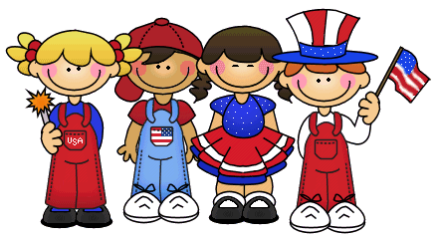
Duties of Citizens
What is a community?
  School, workplace, place of worship, our state, and our country.
Citizens have responsibilities which are things we should do and are obligations that we meet on our own free will.
Duties are actions that we are required to perform.
The national, state, and local governments require American citizens to perform certain duties.
  These duties are set by laws and anyone who fails to perform those duties are subject to penalties under the law.

Slide 43
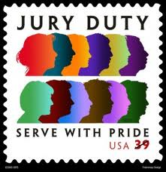
Duties of Citizens
Five of our most important duties and responsibilities as citizens are:
  Serve in Court
  Attend School
  Obey Laws
  Pay Taxes
  Defend the Nation
    Citizens aged 18 – 25 must register with the Selective Service System in case of a national emergency and there is a draft for military service.

Slide 44
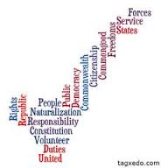
Be an Informed and Active Citizen
Government decisions affect your life.
  Laws might be passed that affect you
  School board might vote on your kids school
  Town council might use your money for a new park
  Homeowners association might use your money to fix the fences
You have a responsibility to know what the government is doing so that you can voice your opinion on those matters.
Citizens are responsible for making sure that the government is working properly.
You can make your voice heard by supporting a cause that you care about, contacting elected officials, and, above all, by voting.
Voting is one of American citizens’ most important responsibilities.
“The ultimate rulers of our democracy are not a President and Senators and Congressmen and Government officials but the voters of this country.” – Franklin D. Roosevelt

Slide 45
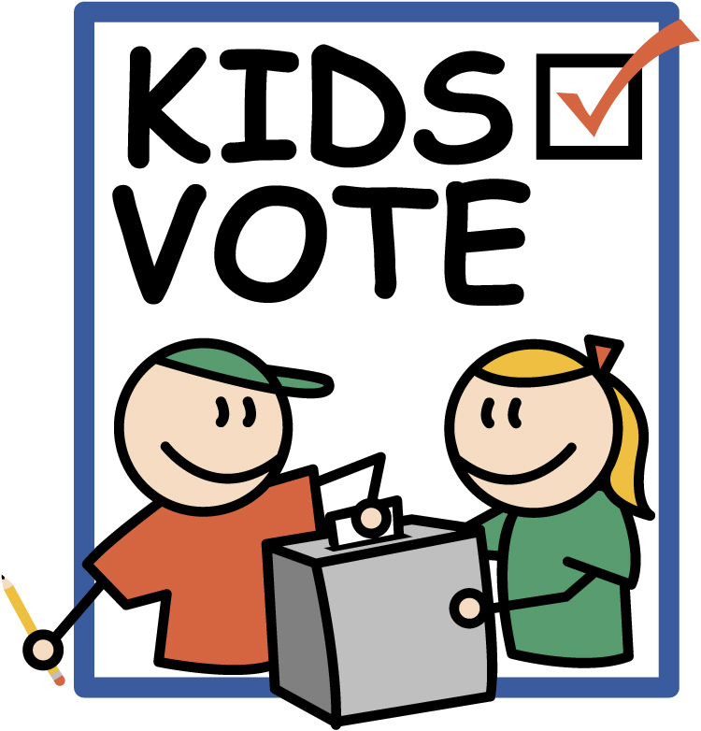
Be an Informed and Active Citizen
Everyone 18 and older has the right to vote.
This shapes the future of their communities, states, and nation by voting.
It is your job to make sure you are informed about what the candidates want to do and accomplish in office and what they are doing and accomplishing in office.
Voting ensures that leadership is changed in a peaceful and orderly manner.

Slide 46
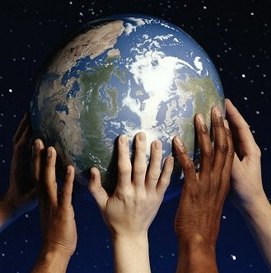
Respect the Rights of Others
Treating others politely and respectfully is also part of being a good citizen.
The U.S. has a very diverse population and respecting and accepting others who are different from you is called tolerance.

Slide 47
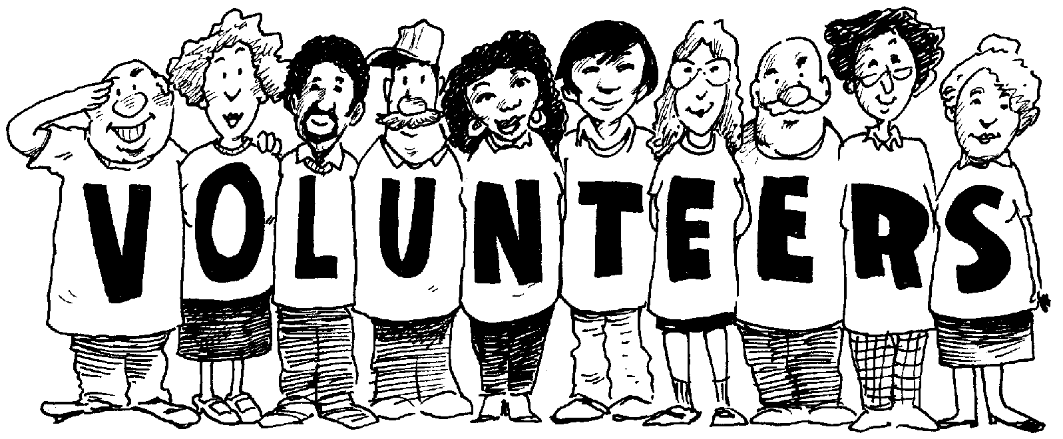
Contribute to the Common Good
Responsible citizens show concern for others as well as themselves.
They are willing to give time, effort, and money to improve community life
Giving your time to work in the community is called volunteerism.
Over 63 million people, aged 16 and up, do volunteer work.
Americans give over $300 billion dollars annually to charity.

Slide 48
Forms of Government
Section 4

Slide 49
Key Terms
Public policy – refers to the decisions and actions a government takes to solve problems in the community.
Resolve – to find a solution to a disagreement
Representative democracy – a government in which citizens choose a smaller group to govern on their behalf
Constitutional monarchy – monarchy in which the power of the hereditary ruler is limited by the country's constitution and laws
Majority rule – political principle providing that a majority of the members of a community has the power to make laws binding up on all the people
Regime – a government that is in power
Authoritarian regime – government in which one leader or group of people holds absolute power.
Totalitarian – describes a system in which government control extends to almost all aspects of peoples lives
Ideology – a body of ideas about life and society

Slide 50
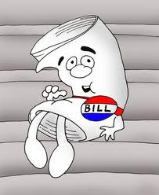
Levels of Government
Federal/National Government
  Makes laws for the nation
  Makes rules for citizenship
  Oversees foreign policy, elections, and the military
State Government
  Makes laws for the state
  Sets up local governments
  Oversees education and public health
Local Government
  Run counties, cities, and towns
  Provide schools, police, and fire departments
  Provide road maintenance, snow removal, trash collection and other services that people depend on every day

Slide 51
National or Federal Government
State Government
Local Government
You

Slide 52
Forms of Government Explained
All governments, no matter their structure (or form) enjoy three powers: the power to create laws (legislative), the power to enforce laws (executive) and the power to adjudicate laws (judicial). The way that those powers are organized determines the form of government. In the United States, for example, the U.S. Constitution begins with “we the people” which speaks to the notion that the U.S. is a democracy. However, as the U.S. Constitution outlines a system of representation through which the people rule, it is known as a republic, or a representative democracy.
Several factors impact the form of government that a nation will adopt; these include, but are not limited to the nation’s history, culture, values, beliefs, political participation, geography, location, international relations, domestic concerns and past practices.

Slide 53
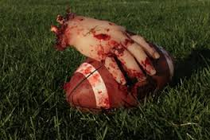
The Importance of Government
If you played a sport without a ref, it would be a free-for-all.
Without government, people would face a world with confusion, violence, and fear.
Government makes it possible to live together peacefully and productively.

Slide 54
Functions of Gov’t
KEEP ORDER | PROVIDE SECURITY
Pass and enforce laws to deter crime | Establish armed forces
Establish courts | Protect citizens from foreign attacks
PROVIDE SERVICES | GUIDE THE COMMUNITY
Protect public health | Develop public policy
Protect public safety | Manage the economy
Provide public welfare | Conduct foreign relations

Slide 55
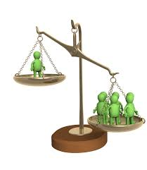
Types of Governments
Democratic Government
  Representative government
    Citizens choose a group of people to represent them, make laws, and govern on their behalf
  Constitutional monarchy
    Monarchy in which the power of the hereditary ruler is limited by the country's constitution and laws
  Majority rule
    A majority of the members of a community has the power to make laws binding upon all the people

Slide 56
Types of Government
Autocracy
  Form of government where one person has unlimited power (dictatorship)
  One form of an autocracy is a dictatorship where a military leader secures power often through violent means. Another form of autocracy is an absolute monarchy where a person becomes the sole leader of a country by being born into a family of rulers.
Communism
  Communism is a classless society (no social classes) in which all property is owned by the community as a whole and where all people are entitled to equal social and economic status.
Direct Democracy
  Democracy means the rule by the people. That is where each individual person has a vote about what to do. Whatever the most people vote for becomes the law. There is no king or tyrant, and anybody can propose a new law.

Slide 57
Types of Government
Monarchy
  form of government in which power is held by a single person whose right to rule is based on birth and who has the power to remain in office for life
Oligarchy
  form of government where most political power is held by a small group in a society, usually the wealthy
Socialism
  a political and economic system where most property and resources are owned or controlled by the public or the government

Slide 58
Representative Democracy
Dictatorship
Executive Branch
(Enforce Laws)
Judicial Branch
(Adjudicate Laws)
Legislative Branch (Create Laws)
Executive Branch
(Enforce Laws)
Judicial Branch
(Adjudicate Laws)
Legislative Branch (Create Laws)
Dictator

Slide 59
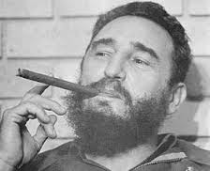
Authoritarian Government
Authoritarian regimes – power is held by a person or a group not accountable to the people
They had unlimited power so they were absolute monarchs
  King of Saudi Arabia and the emir of Qatar are still this today but their decisions must follow Islamic law
Dictatorships are like absolute monarchs because they exercise complete control over the state.
  Come to power through the use of force
  Usually overthrow an existing government
  When serious situation demands a strong leader, the people may welcome the rule of a dictator
  Use police and military to keep their power

Slide 60
Totalitarian Regimes
Government controls almost all aspects of people’s lives.
These rulers often have an ideology, or a strict idea about life and society.
  Decide what industries/factories will produce
  What farmers will grow
  Ban any efforts to oppose them
  Take away individual freedom
  Tell people what they can believe and what groups they may join
  Control the media
  Use scare tactics, violence, and propaganda
Propaganda is the use of persuasive methods to support one’s cause or to damage someone else’s cause

Slide 61
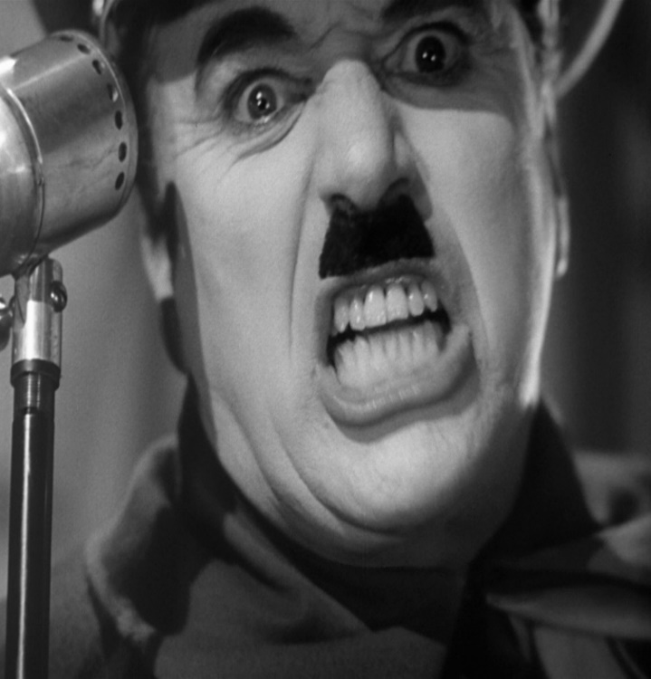
Totalitarian Regimes
Famous totalitarian regimes throughout history:
  Nazi Germany under Adolf Hitler
  Fascist Italy under Benito Mussolini
  Soviet Union under Joseph Stalin
  Cuba under Fidel Castro
    still in power today
  North Korea under Kim Jong un
    still in power today

Slide 62
Systems of Gov’t
Federal System
  power is divided among a central, national government, and smaller self-governing political units such as states
Unitary System
  the central government is supreme. It may create smaller administrative units to carry out some of its functions. But those smaller units are not protected by a constitution
Confederal
  consists of member states that have agreed to join together voluntarily. The states or nations create a common body to carry out certain functions, but they retain their powers

Slide 63
Key Comparisons
An absolute monarchy, autocracy, and monarchy are all led by a single ruler
A representative democracy and republic are the same form of government
Socialism and communism are focused on the economics of a country

Slide 64
Country Examples
Bolivia – Republic
Brunei – Absolute Monarchy
Cuba – Communism
United States – Representative Democracy
Iran – Oligarchy
North Korea – Autocracy
Spain – Monarchy
Switzerland – Direct Democracy
Venezuela – Socialism

Slide 65
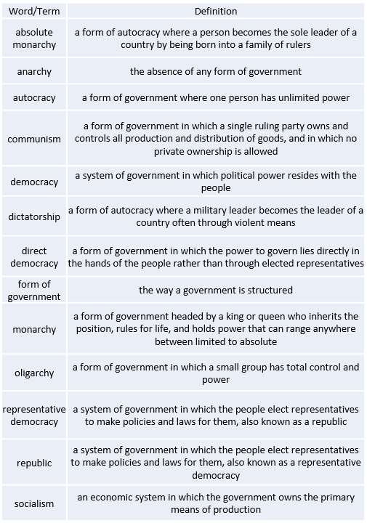
Overview

Slide 66
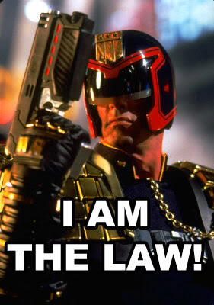
Keep Order and Provide Security
The most important purpose of government is to provide laws, or rules of conduct, for people to follow.
Laws serve to prevent conflicts between individuals, groups, or nations.
When conflicts do occur, laws help resolve, or find a solution, for them.
Governments have the power to enforce the laws they make:
  Police officers
  Courts
  Jails

Slide 67
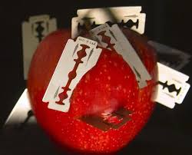
Guide the Community
Public policy refers to the decisions and actions a government takes to solve problems in the community.
  Protection from unsafe products
  Making the nation more secure from attacks
  When government passes laws or develops plans to reach these goals, they are making public policy
Governments make agreements to help each other when attacked

Slide 68
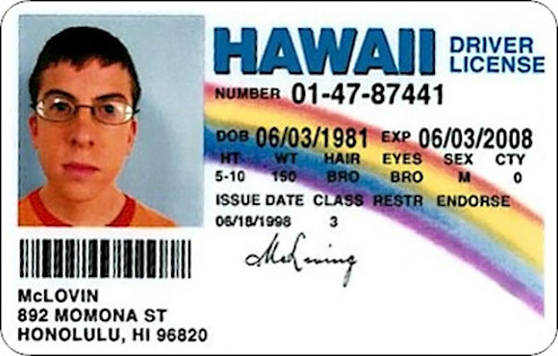
Provide Services
Governments provide many services that people would not get otherwise:
  Libraries
  Schools
  Hospitals
  Parks
  Police
  Fire Departments
  Food
  Monetary support
  Housing, health care, and special programs for people with disabilities
They license drivers and doctors
Agencies make sure that food, medicines, and products from cars to cribs are safe.

Slide 69
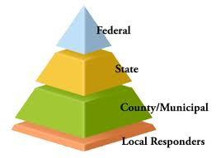
Levels of Government
The U.S. has a federal system of government which means that the power is divided between the federal, or national, government and the states.
In addition, local governments serve towns, cities, and counties.
National government has the highest level of authority over its citizens.
  Makes and enforces laws for the entire country
  State and local governments cannot make any laws that overrule the national government
  National government sets up rules for citizenship
Each of the 50 states has its own government which decides matters for those citizens within their states
  Marriage laws, rules for schooling, public safety, public health, build roads, build bridges, hold elections, and set up local governments
Local governments provide:
  Police and fire departments
  Emergency medical services
  Local courts
  Provide outdoor lighting
  Remove snow from streets

