Slide 1
Colonial Influences Review

Slide 2
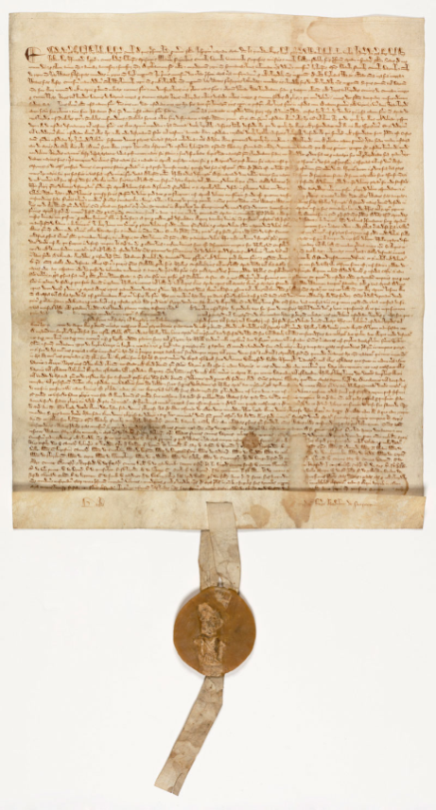
Magna Carta
Purpose: limited the power of the king and protected rights of the nobility
Big Ideas:
Limited Government
Rights
Rule of Law
Due Process

Slide 3
Mayflower Compact
Purpose:
Create a government that would protect the rights of the colonists
Big Ideas:
Self Government
Rule of Law

Slide 4
English Bill of Rights
Purpose:
Further limit the power of the king, increase the power of Parliament, and give more rights to the people
Big Ideas:
Limited Government
Rights
Due Process
Rule of Law

Slide 5
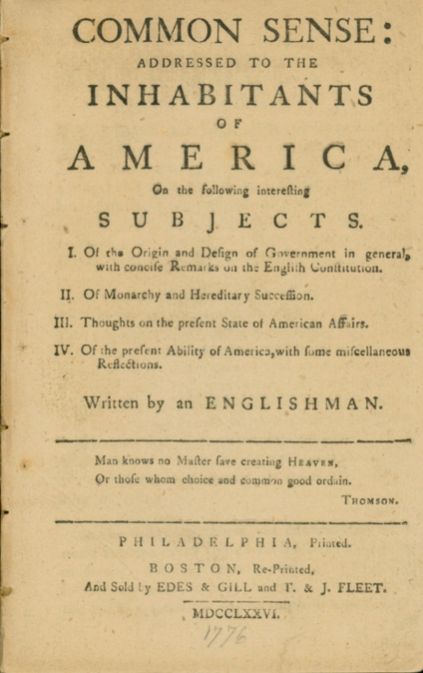
Common Sense
Purpose:
To convince the colonists to support independence
Big Ideas:
Self government
Rights

Slide 6
From Big Ideas to the Constitution
A
“This Constitution and the laws of the United States ... shall be the supreme law of the land.” All government officials “shall be bound by an oath to support this constitution.”
U.S. Constitution, Article VI
Self– Government: popular or representative system where the people create and run their own government
Rule of Law: the idea that all people must follow the laws, and that the laws are enforced fairly
A
Due Process: People have the right to fair and reasonable laws. Officials have to follow rules when enforcing the laws and to treat all people in the same way.
Rights: A set of things that people believe they should be free to do without restrictions
Limited Government: the power of government is limited by the Constitution, and each branch is limited in what it can do

Slide 7
From Big Ideas to the Constitution
B
The first ten amendments in the Bill of Rights guarantees certain rights and freedoms that include:
Freedom of speech, the press, and religion
Right to petition the government and to bear arms
Prohibition of excessive bail or fines, or cruel and unusual punishments for crimes
Self– Government: popular or representative system where the people create and run their own government
Rule of Law: the idea that all people must follow the laws, and that the laws are enforced fairly
Due Process: People have the right to fair and reasonable laws. Officials have to follow rules when enforcing the laws and to treat all people in the same way.
Rights: A set of things that people believe they should be free to do without restrictions
Limited Government: the power of government is limited by the Constitution, and each branch is limited in what it can do
B

Slide 8
From Big Ideas to the Constitution
C
The U.S. Constitution created three branches of government. Each branch is given the power to check, or limit the power of the other two. The system of checks and balances keeps any one branch from getting too powerful.
Self– Government: popular or representative system where the people create and run their own government
Rule of Law: the idea that all people must follow the laws, and that the laws are enforced fairly
Due Process: People have the right to fair and reasonable laws. Officials have to follow rules when enforcing the laws and to treat all people in the same way.
Rights: A set of things that people believe they should be free to do without restrictions
Limited Government: the power of government is limited by the Constitution, and each branch is limited in what it can do
C

Slide 9
From Big Ideas to the Constitution
D
“ No person shall...be deprived of life, liberty, or property, without due process of law”
U.S. Constitution, 5th Amendment
Self– Government: popular or representative system where the people create and run their own government
Rule of Law: the idea that all people must follow the laws, and that the laws are enforced fairly
Due Process: People have the right to fair and reasonable laws. Officials have to follow rules when enforcing the laws and to treat all people in the same way.
Rights: A set of things that people believe they should be free to do without restrictions
D
Limited Government: the power of government is limited by the Constitution, and each branch is limited in what it can do

Slide 10
From Big Ideas to the Constitution
E
“WE THE PEOPLE of the United States...do ordain and establish this Constitution for the United States of America.”
Preamble to the Constitution, 1787
Self– Government: popular or representative system where the people create and run their own government
Rule of Law: the idea that all people must follow the laws, and that the laws are enforced fairly
E
Due Process: People have the right to fair and reasonable laws. Officials have to follow rules when enforcing the laws and to treat all people in the same way.
Rights: A set of things that people believe they should be free to do without restrictions
Limited Government: the power of government is limited by the Constitution, and each branch is limited in what it can do

