Slide 1
EOC Boot camp practice test
Civics

Slide 2
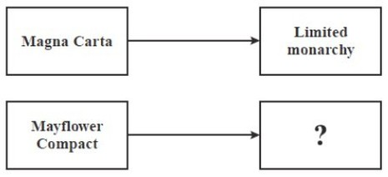
Question 1
The diagram shows that the colonists formed some of their political views from some historical documents.
Which phrase completes the diagram?
A. separation of powers
B. economic freedom
C. self-government
D. individual rights

Slide 3
Answer 1
Why it’s correct:
The colonists who wrote the compact agreed to follow the rules that they had created
C. Self-government

Slide 4
Question 2
The diagram describes a cause that led to the writing of the declaration of independence.
Which action completes the diagram?
A. colonial agriculture trade increases
B. colonial religious devotion increases
C. colonial demand for political change increases
D. colonial demand for military assistance increases

Slide 5
Answer 2
Why it’s correct:
Colonial demand for political change increased as a result of the colonists’ concerns with English policies related to taxation, representation, and individual rights. This option correctly completes the flow chart because the colonists reacted to the British policies that limited their rights by expressing their grievances and demanding political change. The colonists’ grievances were ignored which led to the writing of the Declaration of Independence.
C. colonial demand for political change increases

Slide 6
Question 3
The passage was written by Thomas paine in his 1776 book, “common sense.”
Based on this passage, with which complaint against the king from the declaration of independence would Thomas paine agree?
A. persecuting immigrant groups
B. taking away religious rights
C. taking away political rights
D. persecuting racial groups

Slide 7
Answer 3
Why it’s correct:
The Declaration of Independence listed several complaints, or grievances, about the king’s policies toward the American colonists (imposing taxes with the consent of the people, suspending trial by jury, limiting judicial powers, quartering soldiers, and dissolving legislatures) . These policies denied the colonists their political rights which include having a voice in government.
C. taking away political rights

Slide 8
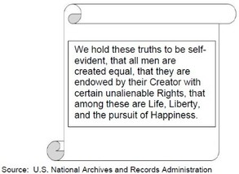
Question 4
This passage is from a historical document.
Which document contains this passage?
A. declaration of independence
B. articles of confederation
C. English bill of rights
D. u.s. constitution

Slide 9
Answer 4
Why it’s correct:
This passage is the opening statement to the Declaration of Independence. The passage is taken from the Preamble of the Declaration of Independence
A. declaration of independence

Slide 10
Question 5
In the preamble to the u.s. constitution, what is the meaning of the phrase “we the people”?
A. the people express their will through political parties
B. the people express their will by directly creating laws
C. government receives taxes from the people and exists to support them
D. government receives its power from the people and exists to serve them

Slide 11
Answer 5
Why It’s correct:
“We the People” is a reference to popular sovereignty, which means that the government exists because the people consent to its establishment. The U.S. government was created by the people and exists to serve the people’s needs.
D. Government receives its power from the people and exists to serve them

Slide 12
Question 6
Based on this passage, which constitutional principle does Madison describe?
A. separation of powers
B. checks and balances
C. popular sovereignty
D. judicial review

Slide 13
Answer 6
Why it’s correct:
Checks and balances is a principle that means that each branch of the federal government has the ability to limit, or check, the powers of the other branches. This is the correct answer because, according to the passage, the “departments” (three branches of government) should have some “[control] over…the acts of each other.”
B. checks and balances

Slide 14
Question 7
The statement was made by Thomas Jefferson in a 1786 letter to john jay. Why should this freedom be guarded?
A. to provide news media with a guaranteed profit
B. to keep the news media from controlling the political process
C. to provide the government with an accurate information source
D. to keep the government from becoming the primary information source

Slide 15
Answer 7
Why it’s correct:
Freedom of the press allows the media to gather news and information which they share with the public. This keeps the government from being the public’s primary information source.
D. to keep the government from becoming the primary information source

Slide 16
Question 8
Which action represents an individual exercising a constitutional right?
A. summary judgment
B. quartering soldiers
C. civil disobedience
D. double jeopardy

Slide 17
Answer 8
Why it’s correct:
This right is protected by the First Amendment freedoms of speech and peaceable assembly.
C. Civil disobedience

Slide 18
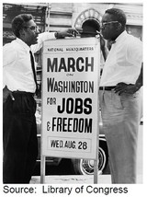
Question 9
The photograph illustrates an event in u.s. history.
What was congress’ response to the social movement symbolized in the photograph?
A. decreased commerce opportunities
B. increased economic opportunities
C. increased religious opportunities
D. decreased military opportunities

Slide 19
Answer 9
Why it’s correct:
This is the correct response because the March on Washington led to the passage of the Civil Rights Act of 1964. The Civil Rights Act prohibited workplace discrimination based on sex, race, color, religion or national origin, which created more economic opportunities for minority groups.
B. increased economic opportunities

Slide 20
Question 10
Which was an outcome of the u.s. supreme court decision in brown v. board of education (1954)?
A. administrators may limit the content of student publications
B. public school districts that segregate deny equal protection
C. students have a reduced expectation of privacy in school
D. criminal defendants have the right to an attorney

Slide 21
Answer 10
Why it’s correct:
The Supreme Court ruled that segregated schools violated the Fourteenth Amendment’s Equal Protection Clause. Segregation in public school districts was found to be unconstitutional.
B. public school districts that segregate deny equal protection

Slide 22
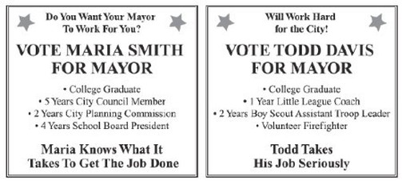
Question 11
The political campaign posters are for two candidates running for mayor.
According to the information on the posters, what is the reason maria could be considered more qualified than todd to be elected mayor?
A. her political policies
B. her college education
C. her campaign promises
D. her experience working in government

Slide 23
Answer 11
Why it’s correct:
Maria has served 5 years on the city council, 2 years on the city planning commission, and 4 years on the school board. All three jobs are part of local government, and Maria is running for mayor, which is also a locally elected position. Todd does not list any locally elected government experiences on his poster.
D. her experience working in government

Slide 24
Question 12
Based on the government system in the united states, which individual activity is used to directly influence legislative decisions?
A. watching political debates on television
B. discussing political issues at work
C. collecting opinions for a yearbook
D. gathering signatures for a petition

Slide 25
Answer 12
Why it’s correct:
This activity will allow individuals to directly influence the lawmaking process by gathering signatures to make a written request to the government showing that many citizens support or discourage specific government actions.
D. gathering signatures for a petition

Slide 26
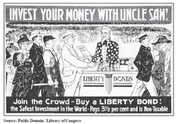
Question 13
The poster was created in 1917.
Which type of communication is shown in this poster?
A. accurate
B. biased
C. informational
D. propagandized

Slide 27
Answer 13
Why it’s correct:
This poster is an example of propagandized communication because the poster is attempting to persuade the viewer to buy a liberty bond to help the United States. The poster is persuading the viewer using bandwagon (“join the crowd”) propaganda
D. propagandized

Slide 28
Question 14
Which action is an example of a foreign-policy decision?
A. congress increased providing support to newly arrived immigrants
B. the president requested a law to regulate pollution near international borders
C. congress raised educational standards to make students competitive in a global market
D. the president signed an executive order restoring relations with a communist government

Slide 29
Answer 14
Why it’s correct:
Foreign policy guides decisions that concern other countries such as executive orders involving relations with other countries.
D. the president signed an executive order restoring relations with a communist government.

Slide 30
Question 15
A country with very strong economic ties to the united states is allowing human rights violations to take place. Based on u.s. foreign policy, which is an appropriate first response?
A. initiate a trade ban
B. initiate public protests
C. initiate diplomatic talks
D. initiate a military operation

Slide 31
Answer 15
C. initiate diplomatic talks
Why it’s correct:
The Department of State usually initiates diplomatic talks before the United States takes more severe measures to resolve an international conflict.

Slide 32
Question 16
The newspaper headline describes an event in u.s. history.
Which parts of the national government participated in the process described in the newspaper headline?
A. senate and president
B. supreme court and president
C. house of representatives and senate
D. supreme court and house of representatives

Slide 33
Answer 16
Why it’s correct:
Article II of the U.S. Constitution delegates the power to negotiate treaties to the president. Article II also requires that treaties be ratified (approved) by the Senate
A. Senate and president

Slide 34
Question 17
Which statement describes a similarity between the state and the federal governments under the u.s. constitution?
A. both levels of government allow for the election of judges
B. both levels of government have the power to ratify treaties
C. both levels of government allow for the collection of taxes
D. both levels of government have the power to appoint ambassadors

Slide 35
Answer 17
Why it’s correct:
Article I of the U.S. Constitution enumerates the power to tax which is delegated to Congress. The 10th Amendment also reserves the power to collect taxes to the states. Therefore, the power to collect taxes is a concurrent power.
C. both levels of government allow for the collection of taxes.

Slide 36
Question 18
The passage was written by u.s. senator barack Obama in his 2006 book, “the audacity of hope.”
Based on the passage, which statement about the amendment process would senator Obama support?
A. the ratification process allows the president to reflect public views
B. the ratification process allows governors to reflect public views
C. the u.s. constitution is difficult to amend
D. the u.s. constitution is easy to amend

Slide 37
Answer 18
Why it’s correct:
The passage supports this response. The “machinery” of the amendment ratification process (“framework and rules”) forces those participating in the amendment process to think about and discuss proposed amendments (“force us into a conversation”) rather than quickly accepting or rejecting a proposed U.S. Constitutional change.
C. the u.s. constitution is difficult to amend

Slide 38
Question 19
What do the highest courts of florida and the united states have in common?
A. both have the same number of justices
B. both have chief justices
C. justices serve for life with good behavior
D. justices serve for set terms of office

Slide 39
Answer 19
B. both have chief justices
Why it’s correct:
Both the U.S. Supreme Court and the Florida Supreme Court are led by chief justices

Slide 40
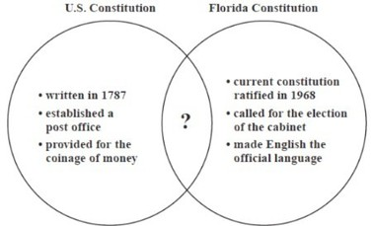
Question 20
The venn diagram compares some features of the u.s. and florida constitutions
Which feature completes the venn diagram?
A. created property taxes
B. established a zoning board
C. required a balanced budget
D. guaranteed individual freedoms

Slide 41
Answer 20
Why it’s correct:
The Bill of Rights in the U.S. Constitution and the Declaration of Rights in the Florida Constitution both guarantee basic freedoms and individual liberties
D. guaranteed individual freedoms

Slide 42
Question 21
Which part of the florida constitution protects individual rights?
A. declaration of rights
B. bill of rights
C. amendments
D. preamble

Slide 43
Answer 21
A. declaration of rights
Why it’s correct:
The Declaration of Rights is the part of the Florida Constitution that protects the basic individual rights of all Floridians

Slide 44
Question 22
The diagram shows some of the steps involved in creating a Florida state law.
What is the next step in the lawmaking process?
A. the governor signs the bill into law
B. the bill goes to the senate for action
C. the people vote on the bill in an election
D. the bill goes to the supreme court for a hearing

Slide 45
Answer 22
B. the bill goes to the senate for action
Why it’s correct:
Both the House and the Senate must approve all state bills. Once a bill passes through the state House, the Senate must vote on the bill. If the state Senate approves the bill, the governor will either sign it into law or veto it.

Slide 46
Question 23
Which is delegated to the national government?
A. conducting elections
B. establishing courts
C. coining money
D. taxing citizens

Slide 47
Answer 23
Why it’s correct:
This is an enumerated power delegated to the national government in Article I, section 8 of the U.S. Constitution.
C. coining money

Slide 48
Question 24
Which option presents a clear point of view?
A. bias
B. metaphor
C. propaganda
D. symbolism

Slide 49
Answer 24
Why it’s correct:
This is the correct response because bias is an opinion that clearly supports one point of view over another.
A. bias

