Slide 1
Greenwood lakes first day procedures
Mr. Rappaport – 7th grade civics

Slide 2

Schedule check
Does your schedule say:
  Rappaport – 7th grade civics
  Room 9-007

Slide 3
Learning Goal
Students will be able to . . . Learn and understand the school and classroom rules, school and classroom procedures, classroom learning structure, and both the Mcgraw-hill website and my student website.

Slide 4
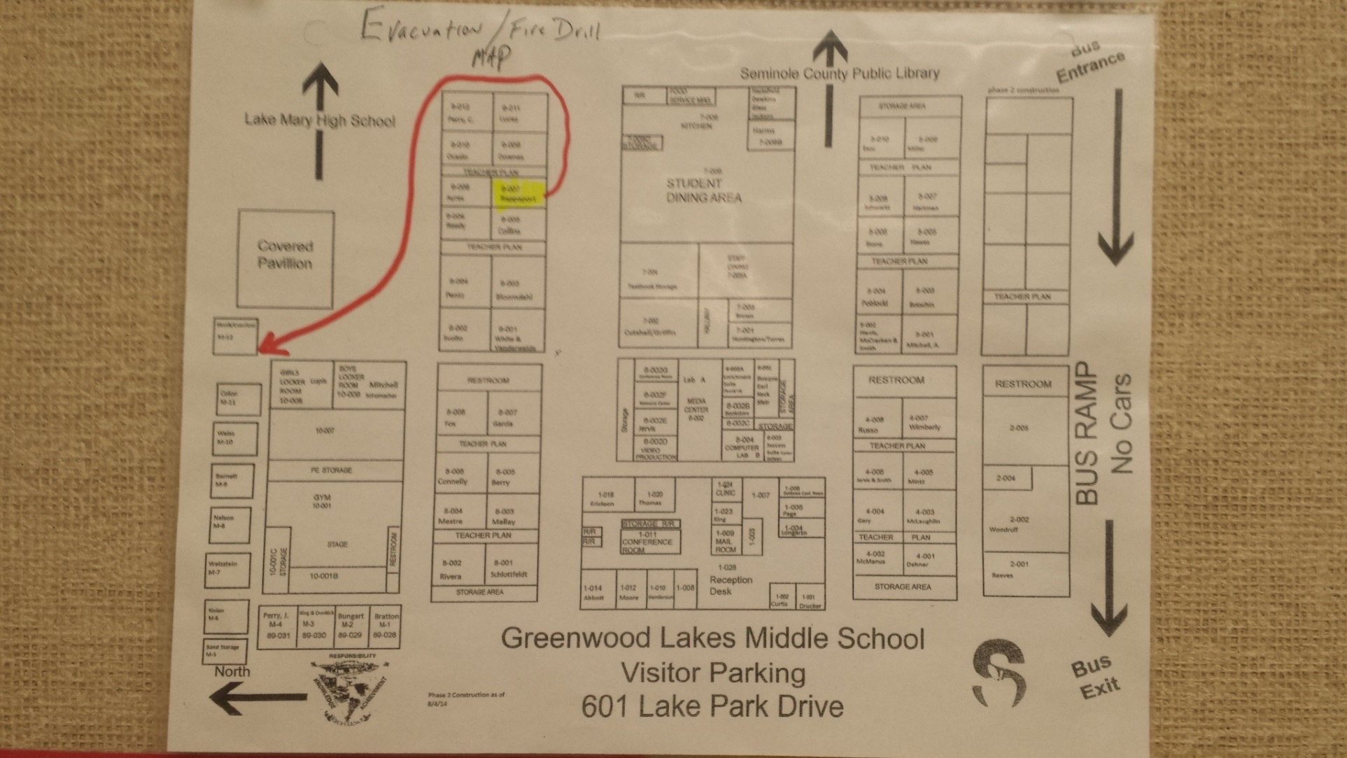
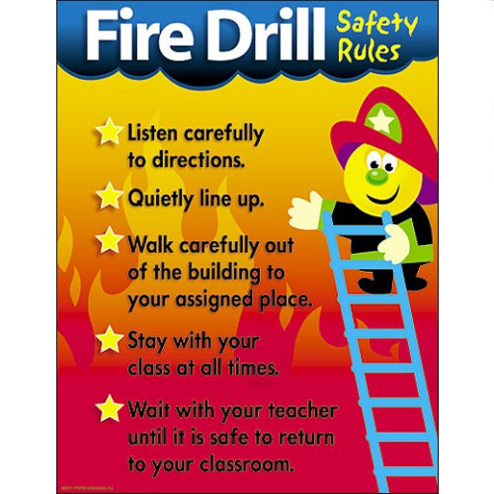
Fire drill procedures

Slide 5

Restroom procedures
Students are not permitted to leave the classroom during the:
  First ten minutes of class
  Last ten minutes of class
No planner – no pass!!!
  Fill out your planner before you ask me to sign it
Sign out In the appropriate binder – by class period
  Name
  Date
  what time you left
  what time you returned

Slide 6

Tardy policy
If you are not in the door when the bell rings, you are tardy.
If you are locked out, please report to the Success suite in room 6-003 to obtain an entry pass. If you fail to return with a pass, you will be marked absent.
if you miss an assignment or pop-quiz, you will have to make it up on your own time or it will be marked as a zero.

Slide 7

When do you go to Lunch
Monday, Thursday, & Friday
  Based on your 4th period class
Tuesday
  Based on your 5th period class
Wednesday
  based on your 4th period class
My class is “B” lunch
Ask your teacher in those periods if you go to “A” lunch or “b” lunch

Slide 8
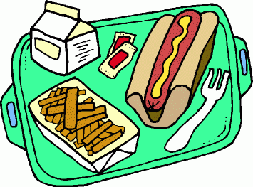
Lunch procedures
Walk, not run
Enter through door closest to learning center
Select a line and remain quietly in place
Enter kitchen in a single line
Select your meal – entire meal must be selected at this time
Need permission to re-enter line
Tell cashier your number – same as last year
New students will receive help from cashier
Proceed to seat and remain there until dismissed
Throw trash away as you leave. No food or drink may go with you

Slide 9

Dress code
Shorts and skirt lengths must be closer to knee than thigh
Pants and shorts must sit at the waist and underwear must not be seen
Shirts must have sleeves and/or a collar

Slide 10
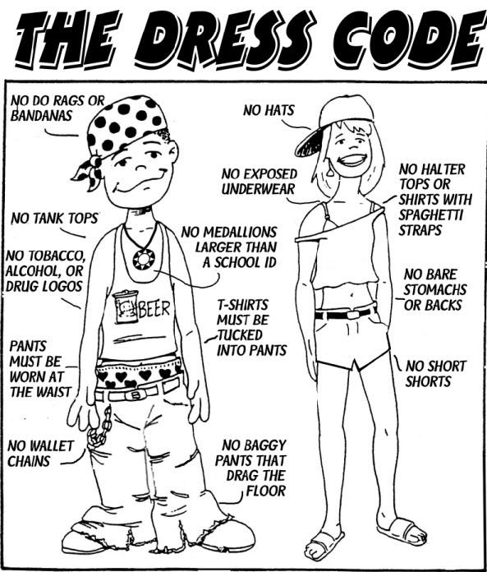
Not permitted
Do not wear:
  Backless tops, halter tops, tube tops, tank tops, spaghetti straps, one shoulder tops, off the shoulder tops, muscle shirts, midriff shirts, and yoga pants
  Pajamas, sleep pants, and blankets
  Caps, hats, scarves, bandanas, hose hats, and sunglasses
  Chains and wallet chains
  Cleats, slippers, and wheelie shoes

Slide 11

expectations
Respect: for others, for school property, for property of others, and for opinions of others
Bullying and harassment are never permitted and should be reported immediately
Responsibility: to attend class on time and be prepared, to report dangerous or hazardous situations, and to report threats of harm
Engagement: listen courteously, participate in class, submit original work, and join clubs

Slide 12
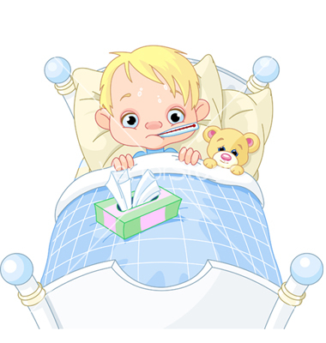
Absences
Parents must send a signed note or doctor’s note to identify illness and to receive an excused absence. Students must take notes to Mrs. Gordillo in the front office.
It is the Students responsibility to obtain and complete all missed coursework and assignments.

Slide 13
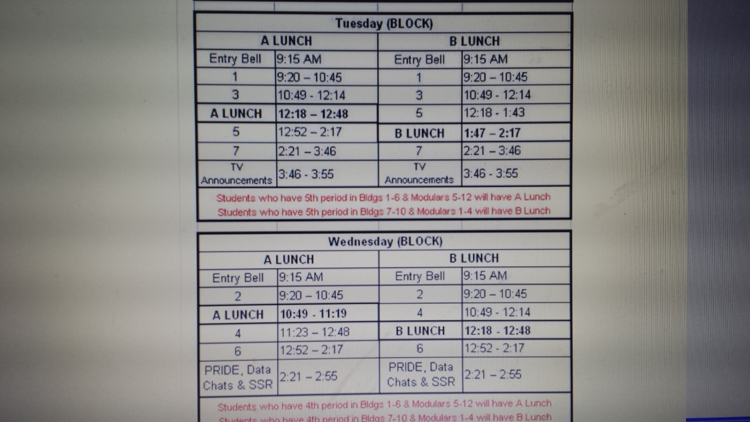
Block schedule

Slide 14

Dismissal procedures
Students must be off campus by 4:30pm unless involved in help sessions with a teacher, clubs/sports, or 21st century
Bus riders will go directly to the buses
  Mr. harms will answer questions
Car riders will go to the front of the school and wait on the sidewalk for their ride
Walkers and bike riders are to exit from the front and not go to the bus ramp. You must walk the sidewalk to go to the library due to construction

