Slide 1
Supreme court cases
Civics

Slide 2
Landmark
What does landmark mean?
Landmark: an important or unique decision, event, fact, discovery, etc.
You are going to learn about landmark U.S. Supreme Court cases and that one characteristic of landmark cases is that they have had a big impact on society.

Slide 3
Marbury v. madison
Supreme court cases
civics

Slide 4
Marbury v. madison
Your task will be to take notes on the following questions (write questions on your own paper):
1. What is the Supremacy Clause in Article VI of the U.S. Constitution?
2. What is the U.S. Supreme Court and what is the role of this court?
3. What is judicial review? What Supreme Court case is associated with judicial review?
Video Link: http://education-portal.com/academy/lesson/us-constitution-definition-and-the-judicial-review-of-marbury-v-madison.html

Slide 5
Marbury v. Madison
“Based on what we learned in the video:
why is Marbury v. Madison considered a landmark Supreme Court case?”
Marbury v. Madison is a landmark Supreme Court case because it established the power of judicial review.

Slide 6
Plessy v. ferguson
Supreme court cases
civics

Slide 7
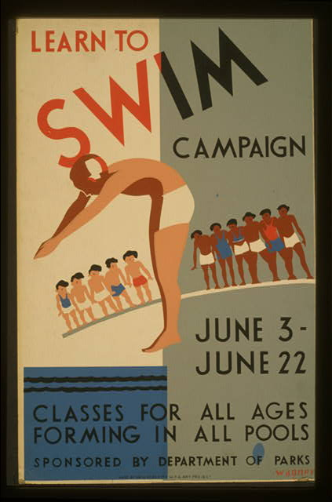
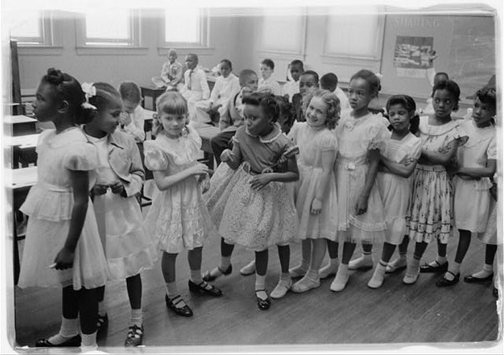
Look at these images

Slide 8
What is happening in both of these images?
How do you know?
What do you think is the issue in each image?
what evidence helps you identify the issue?

Slide 9
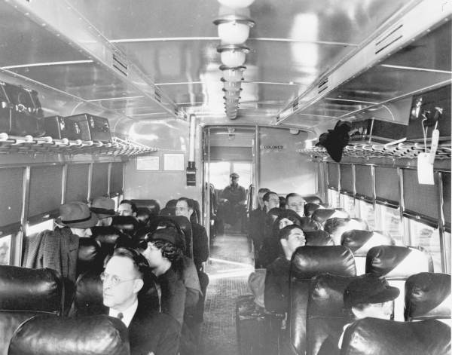
Plessy v. ferguson

Slide 10
Plessy v. ferguson
“What do you think is going on in this photograph?
What is the issue on which it is focusing?
How do you know?
How do you think the people in this photograph feel?”

Slide 11
Plessy v. ferguson
On your own sheet of paper, answer these questions.
What does “opinion” mean as it appears in the reading?
What is the essential question?
How would you summarize the background of the case in 3 sentences or less?
List and Summarize both amendments that deal with this case.

Slide 12
Plessy v. ferguson
This was called “separate but equal.”

Slide 13
Write down your group & court case
 | Gideon v. Wainwright | Miranda v. Arizona | In re Gault | Tinker v. Des Moines
Pd. 2 | Lilly, Nick | Aren, Addy | Jade, Justin, Ian | Alyssa, Jose, David
Pd. 3 | Alana, Anthony, Kayla | Felicity, Collin, April | Ja'kila, Jeanxiel, Joseph | Jameria, Alyssa, Leilani
Pd. 4 | Chloe, Lindsey, Sam | Brittany, Katie, Aleeah | Jolyn, Justin, Nick | Antonella, Jose, Yedel, Jacob
Pd. 5 | Raymond, Jacob, Iyawna | Yvens, Brennon, Sydney | Corin, Malaki, Iyana | Ashantie, Piper, A.J.
Pd. 6 | Caliayh, Marissa | Kiyah, Nick B., Zaza | Dashawn, Victor | Treveon, Adreanah
Pd. 7 | John, Austin, Eddie | Labennie, Hector, Libby | Gianella, Lorenzo, Madison | Dylan, Frankie, Eryn
 | United States v. Nixon | Hazelwood v. Kuhlmeier | Bush v. Gore | District of Columbia v. Heller
Pd. 2 | Annemarie, Dylan, Jamal | Tatiana, Aidan, Aaliyah | Aaron, Gregorio, La'miya | Cody, Paul
Pd. 3 | Christian, Kevin, Kleber | Kaitlyn, Qasim, Jordyn | Hannah, Gina, Jessica | Julie, Meagan
Pd. 4 | Monika, Devin, Jarvkevia | Idil, Noel, Jackson | Caitlyn, Aaliyah, Armarie | Kate, Stephen, Isaiah
Pd. 5 | Avery, Raidah, Samantha | Nick, Mileysha, Larnelle | Zachary, Ladarron, Catalina | Madison, Josh, April
Pd. 6 | Roman, Corben, Janiah | Bryce, Madison, Nick V. | Demontae, Geary, Kaitlyn | Isaac, Hannah, Alex
Pd. 7 | Riya, Daniel, Jason | Jovanny, Colin, Quintaj | Cyanela, Kyara, Deanna | Natalie, Victoria, Isabella

Slide 14
Brown v. Board of education
Supreme court cases
civics

Slide 15
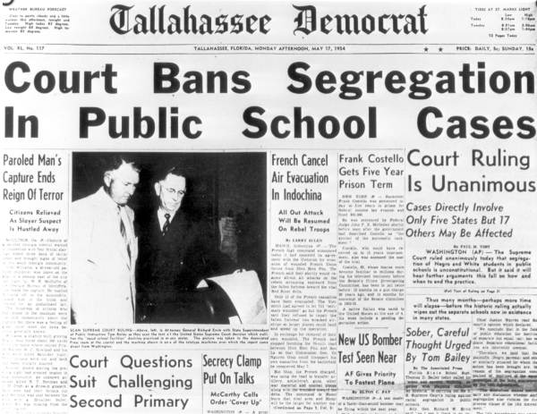
Brown v. board of education
What is the headline in the photograph about?
How do you know?
Why do you think the Tallahassee democrat made this the front-page headline?

Slide 16
Brown v. board of education
What is happening in this photograph?
How do you know?
How might this photograph be related to the outcome of brown v. board of education?

Slide 17
Brown v. board of education
Key points:
The U.S. Supreme Court used intangible (unseen, not measurable) evidence to determine that the 14th Amendment's equal protection clause was violated.
The U.S. Supreme Court's decision was impactful in that it applied to all children enrolled in school, which was (and still is) required by state and federal law.
The U.S. Supreme Court ruled unanimously in this case which is rare for such a controversial issue.
The case broadened the interpretation of the equal protection clause, which set a precedent for later equal protection cases.

Slide 18
How do these images relate to the judicial branch?
Which court case is the first picture?
which court case is the second picture?

