Slide 1
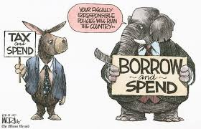
Political Parties
What’s the Difference?

Slide 2
What is a political party?
A political party is a group of people with broad, shared interests.
They join together to help the candidates they support win elections and they also work to shape government policy.
Two parties have competed for power during most of our nation’s history.
This is known as the two-party system

Slide 3
Functions of Political Parties
Nominate candidates
Support candidates
Communicate with citizens
Run the government
Link different parts of government
Act as a watchdog over government

Slide 5
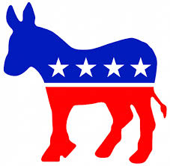
The democratic Party

Slide 6
Democratic party ideas:
More support for programs (healthcare, education, etc.)
Higher taxes for the wealthy
Individual rights
Gay Rights
Gun Control

Slide 7
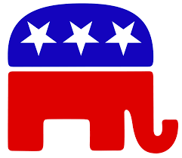
The Republican party

Slide 8
Republican Party Ideas:
Less government
Lower taxes
Family values
Favor 2nd Amendment
Favor the rights of businesses

Slide 9
Which spending increase would the democratic party likely support?
Homeland security
Education
Space exploration
military

Slide 10
Which position would most likely be found in the Republican party platform?
Support for the Affordable Care Act
Opposition to American intervention oversees in the War on Terror
Demand for increased taxation of corporations to support pre-school programs
Introduction of tax incentives for small businesses to support better job growth

Slide 11
Third Parties
A third party is a minor political party.
Third Parties form:
To challenge major parties’ ideas
To support a single issue
To support a candidate
To promote their beliefs about government

Slide 12
The libertarian party
Wishes to maximize human freedom and reduce government and taxation.

Slide 13
The socialist party
Favors more public services, public ownership of utilities and some industries.

Slide 14
The communist party
Believes capitalists exploit workers, revolution needed to achieve change.

Slide 15
The green party
Wants more attention placed on the environment.

Slide 16
“We the workers and our allies, need to take power from the hands of the wealthy few, their corporations, and their political operatives.” Which political party’s position is represented by this statement?
Communist
Democratic
Republican
Socialist

Slide 17
Which position would most likely be found in the libertarian party platform?
Support for the Affordable Care Act
Support for absolute freedom of speech and religion
Support for higher taxation to provide more government services
Support for increased regulation of business to curb the exploitation of natural resources

Slide 18
Primary source activity
Read the following from selected planks of the Democratic and Republican Party platforms and answer the questions that follow.

Slide 19
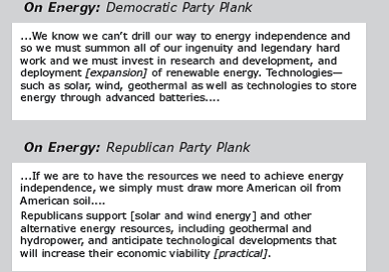

Slide 20
What is the major difference between the democratic and republican position on energy?

Slide 21
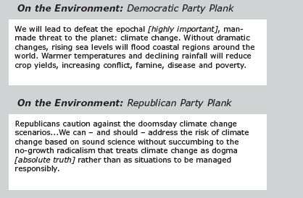

Slide 22
Which party platform views climate change as an imminent threat?

Slide 23
As you read in Lesson 2, use the graphic organizer to identify the roles of political parties and what they do.
Political Party Roles

Slide 24
Political Party Poster

Slide 25
Exit Ticket: Summarize the ideas of 2 of the political parties discussed today.

