Slide 1
Review the Scale and rewrite the learning goal in your own words.

Slide 2
What do these symbols represent?

Slide 3
What comes to mind when you see:
DEMOCRAT
Write down the first three words that come to mind.

Slide 4
What comes to mind when you see:
REPUBLICAN
Write down the first three words that come to mind.

Slide 5
IN your group:
Share your list of words for each political party with your shoulder partner
Combine your lists into one master list for all of the terms you and your shoulder partner came up with (do not include duplicates)
Questions for Discussion
Where have you heard these terms before?
What made you think of a particular word in reference to a political party?
Notes:
Discuss responses and keep a running list of words on display. Use questions for discuss to debrief.

Slide 6
Am I a democrat or a republican? Survey
Directions: Number a piece of paper from 1-11. For the following issues, choose which statement, A or B, best represents your views. Write the letter of your choice on your paper.

Slide 7
1. Flag Burning:
Flag burning is political speech and is protected by the Constitution
Protect the flag from burning by Constitutional amendment.

Slide 8
2. Gun control:
Gun control is necessary and guns should be restricted.
Gun control is unconstitutional and responsible citizens should be able to purchase weapons as they choose.

Slide 9
3. Natural Environment:
Strong regulations are needed to protect the environment.
Strong environmental laws harm the economy and increase the costs of goods and services.

Slide 10
4. Race Relations:
Strong anti-discrimination laws are needed.
People and businesses can be trusted not to discriminate.

Slide 11
5. Minimum Wage:
Increase the minimum hourly wage to help low-income workers and families.
Do not raise the minimum wage because it hurts businesses and increases the costs of goods and services.

Slide 12
6. Healthcare:
Government should provide universal access to healthcare.
Government should limit its role in healthcare and citizens can choose or refuse to purchase health insurance.

Slide 13
7.Taxes:
Increase taxes on the wealthy to pay for public programs and services.
Cutting taxes for everyone helps the economy.

Slide 14
8. Military:
Cut military spending; expand veterans’ benefits; cooperate with other nations and support NATO and the UN.
Increase military spending; cut veterans’ benefits; don’t be constrained by other nations or by NATO or the UN.

Slide 15
9. Death penalty:
Oppose: it does not prevent crime and is unevenly enforced, focusing on poor minority criminals.
Support: it is a necessary and effective deterrent and the only appropriate penalty for certain crimes

Slide 16
10. Gay rights:
Gay rights and marriage are civil rights shared by all
Marriage is a sacred trust between a man and woman. A Constitutional amendment should define marriage as only between a man a woman.

Slide 17
11. Prayer in schools:
Oppose: it is a violation of the separation between church and state
Favor: it is a religious right and part of our American tradition

Slide 18
Count the number of A and B responses.

Slide 19
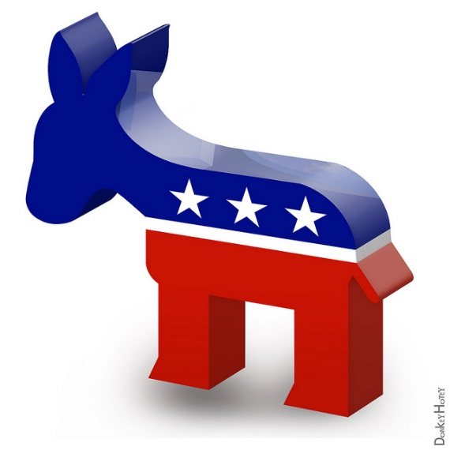
If you have more A’s, you’re a…
DEMOCRAT

Slide 20
If you have more B’s, you’re a…
REPUBLICAN

