Slide 1
Real Florida Laws & Other states too
Civics/American Law
Mr. Rappaport

Slide 2
Florida
It is illegal for a doctor to ask a patient whether they own a gun

Slide 3
Florida
The state constitution allows for freedom of speech, a trial by jury, and pregnant pigs to not be confined in cages.

Slide 4
Florida
Doors of all public buildings must open outwards

Slide 5
Florida
It is illegal to sell your children

Slide 6
Florida
Women can be fined for falling asleep under the hair dryer, as can the salon owner

Slide 7
Florida
A special law prohibits unmarried women from parachuting on Sunday or she shall risk arrest, fine, and/or jailing

Slide 8
Florida
If an elephant is left tied to a parking meter, the parking fee has to be paid just as it would for a vehicle.

Slide 9
Florida
It is illegal to sing in public while attired in a swimsuit

Slide 10
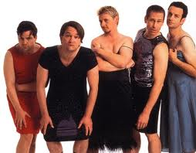
Florida
Men may not be seen publicly in any kind of strapless gown

Slide 11
Florida
It is illegal to skateboard without a license

Slide 12
Florida
You may not pass gas in public after 6pm

Slide 13
Florida
It is illegal for an owner of a store to allow another person to pass out free ducklings in front of the store

Slide 14
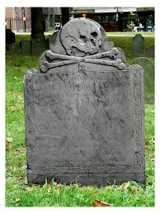
Florida
If you like or love riding your bicycle in the city of Destin, don’t lean it up against a tree in a cemetery

Slide 15
Florida
In Miami, no one may bring a pig with them to the beach

Slide 16
Ohio

Slide 17
Ohio
It is illegal to fish for whales on Sunday

Slide 18
Ohio
It is illegal to get a fish drunk

Slide 19
Ohio
It is illegal to display colored chickens for sale

Slide 20
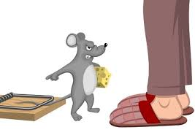
Ohio
It is illegal to catch mice without a hunting license

Slide 21
Ohio
A policeman may bite a dog to quiet him

Slide 22
Alabama
Boogers may not be flicked into the wind.

Slide 23
Alaska
No one may tie their pet dog to the roof of a car.

Slide 24
Arizona
Donkeys cannot sleep in bathtubs

Slide 25
Arkansas
It is illegal to walk a cow down main street after 1pm on a Sunday

Slide 26
California
Nobody is allowed to ride a bicycle in a swimming pool.

Slide 27
Colorado
It is illegal to throw a missile at a car

Slide 28
Connecticut
In order for a pickle to officially be a pickle it must bounce

Slide 29
Georgia
No one may carry an ice cream cone in their back pocket if it is a Sunday

Slide 30
Hawaii
Coins are not allowed to be placed in one’s ear

Slide 31
Idaho
You may not fish on a camel’s back

Slide 32
Kentucky
It is illegal to fish with a bow and arrow

Slide 33
Louisiana
Persons could land in jail for up to ten years for stealing an alligator

Slide 34
Maine
After Jan. 14th, you will be charged a fine for having your Christmas decorations still up

Slide 35
Maryland
It is illegal to take a lion to the movies

Slide 36
Michigan
A woman isn’t allowed to cut her own hair without her husband’s permission

Slide 37
Minnesota
A person may not cross state lines with a duck atop his head

Slide 38
Mississippi
One may be fined up to $100 for using “profane language” in public places

Slide 39
Missouri
Frightening a baby is in violation of the law

Slide 40
Montana
I’m worried bro!!
Worrying squirrels will not be tolerated

Slide 41
Nebraska
If a child burps during church, his parents may be arrested

Slide 42
New Hampshire
On Sundays, citizens may not use the restroom while looking up

Slide 43
New Jersey
It is illegal to wear a bullet-proof vest while committing murder

Slide 44
New Mexico
Idiots may not vote

Slide 45
New York
While riding in an elevator, one must talk to no one and fold his hands while looking toward the door

Slide 46
New York
Citizens may not greet each other by “putting one’s thumb to the nose and wiggling the fingers”

Slide 47
North Carolina
It’s against the law to sing off key

Slide 48
North Dakota
It is legal to shoot an Indian on horseback, provided you are in a covered wagon

Slide 49
Oklahoma
People who make “ugly faces” at dogs may be fined and/or jailed

Slide 50
Oregon
Canned corn is not to be used as bait for fishing

Slide 51
Pennsylvania
It is illegal to sleep on top of a refrigerator outdoors

Slide 52
Rhode Island
It is illegal to bite off another person’s leg

Slide 53
Tennessee
It is legal to gather and consume roadkill

Slide 54
Texas
It is illegal to sell one’s eye

Slide 55
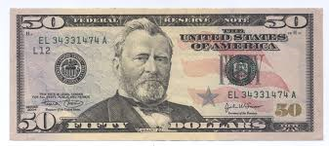
Utah
Throwing snowballs will result in a $50 fine

Slide 56
Vermont
Women must obtain written permission from their husbands to wear false teeth

Slide 57
Washington
The harassing of Bigfoot, Sasquatch, or other undiscovered sub-species is a felony punishable by a fine and/or imprisonment

Slide 58
West Virginia
Whistling underwater is prohibited

Slide 59
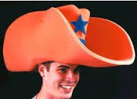
Wyoming
It is illegal to wear a hat that obstructs people’s view in a public theater or place of amusement

Slide 60
Separated at Birth???

