Slide 1
Supreme Court Cases
Civics

Slide 2
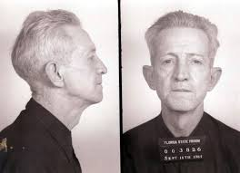
Gideon v. Wainwright
Constitutional Principle:
6th Amendment – right to a lawyer
14th Amendment – Equal Protection Clause
Impact:
Right to a lawyer, even if you cannot afford one

Slide 3
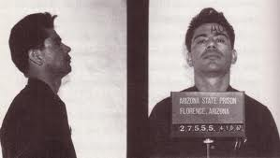
Miranda v. Arizona
Constitutional Principle:
5th Amendment – Self-incrimination
14th Amendment – Equal Protection Clause
Impact:
Protection from self-incrimination and knowing your rights if you are arrested

Slide 4
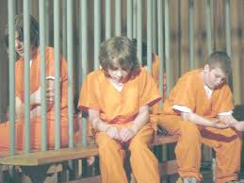
In re Gault
Constitutional Principle:
14th Amendment: Equal Protection Clause
Impact:
Determined that juvenile court must comply with the 14th Amendment’s Equal Protection Clause

Slide 5
Tinker v. Des Moines
Constitutional Principle:
1st Amendment: Freedom of Speech
14th Amendment: Equal Protection Clause
Impact:
Upheld student’s First Amendment right to engage in symbolic speech in school

Slide 6
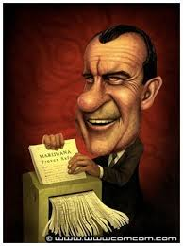
U.S. v. Nixon
Constitutional Principle:
Executive Privilege: President’s conversations are private
Rule of Law
Impact:
U.S. Supreme Court Limited executive privilege/no one is above the law –Rule of Law

Slide 7
Hazelwood v. Kuhlmeier
Constitutional Principle:
1st Amendment – Freedom of Speech
Impact:
Determined that the First Amendment does not protect all types of student speech in school

Slide 8
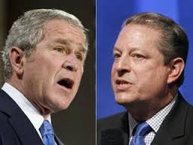
Bush v. Gore
Constitutional Principle:
14th Amendment – Equal Protection Clause
Impact:
Determined that states cannot violate 14th Amendment when undertaking election recounts

Slide 9
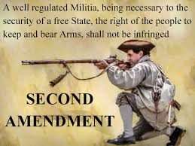
District of Columbia v. Heller
Constitutional Principle:
2nd Amendment – Right to bear arms
Impact:
Upheld that the 2nd Amendment protects an individual’s right to possess a firearm

